Slide 1


Slide 2
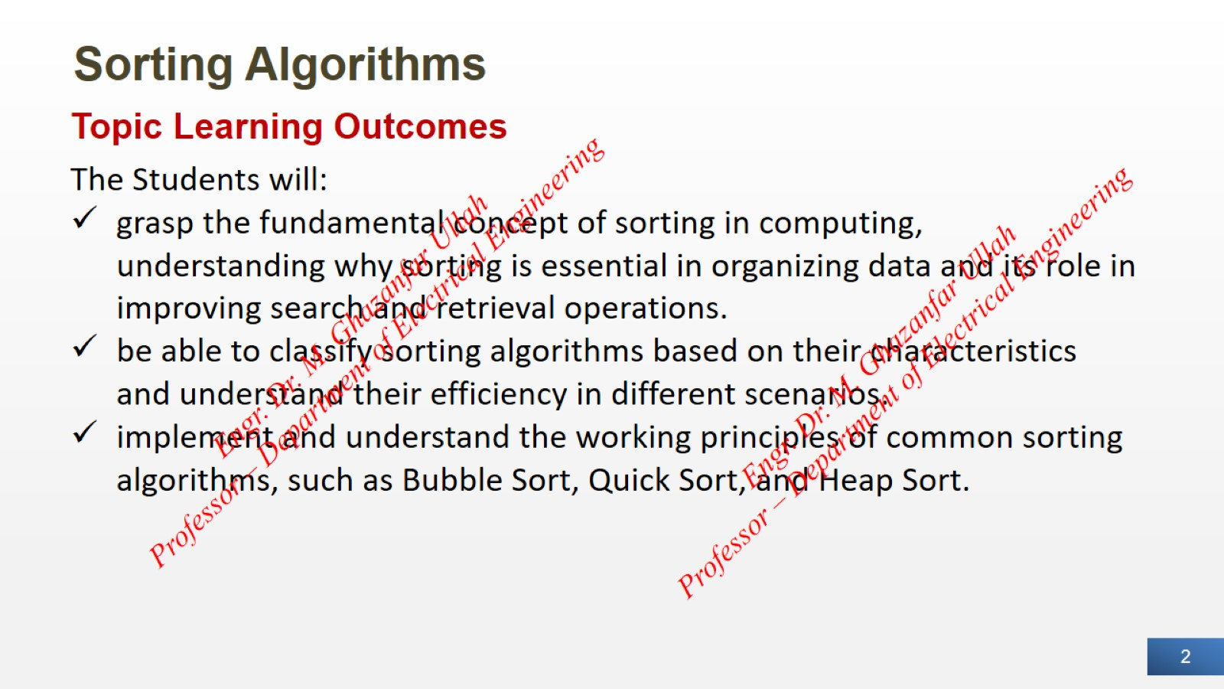
Sorting Algorithms

Slide 3
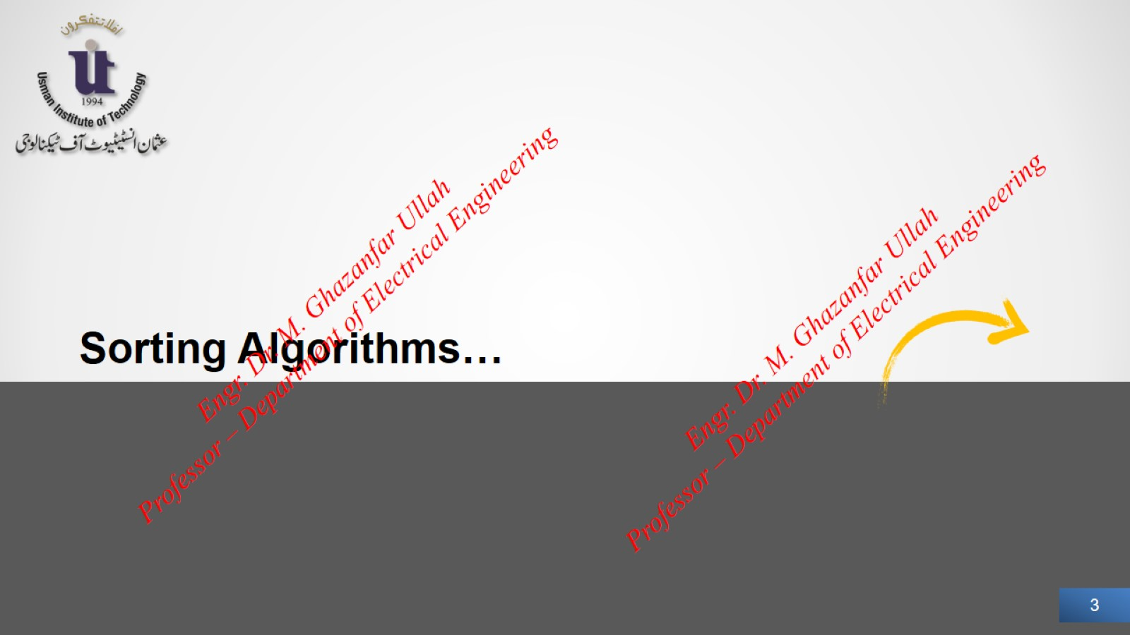

Slide 4
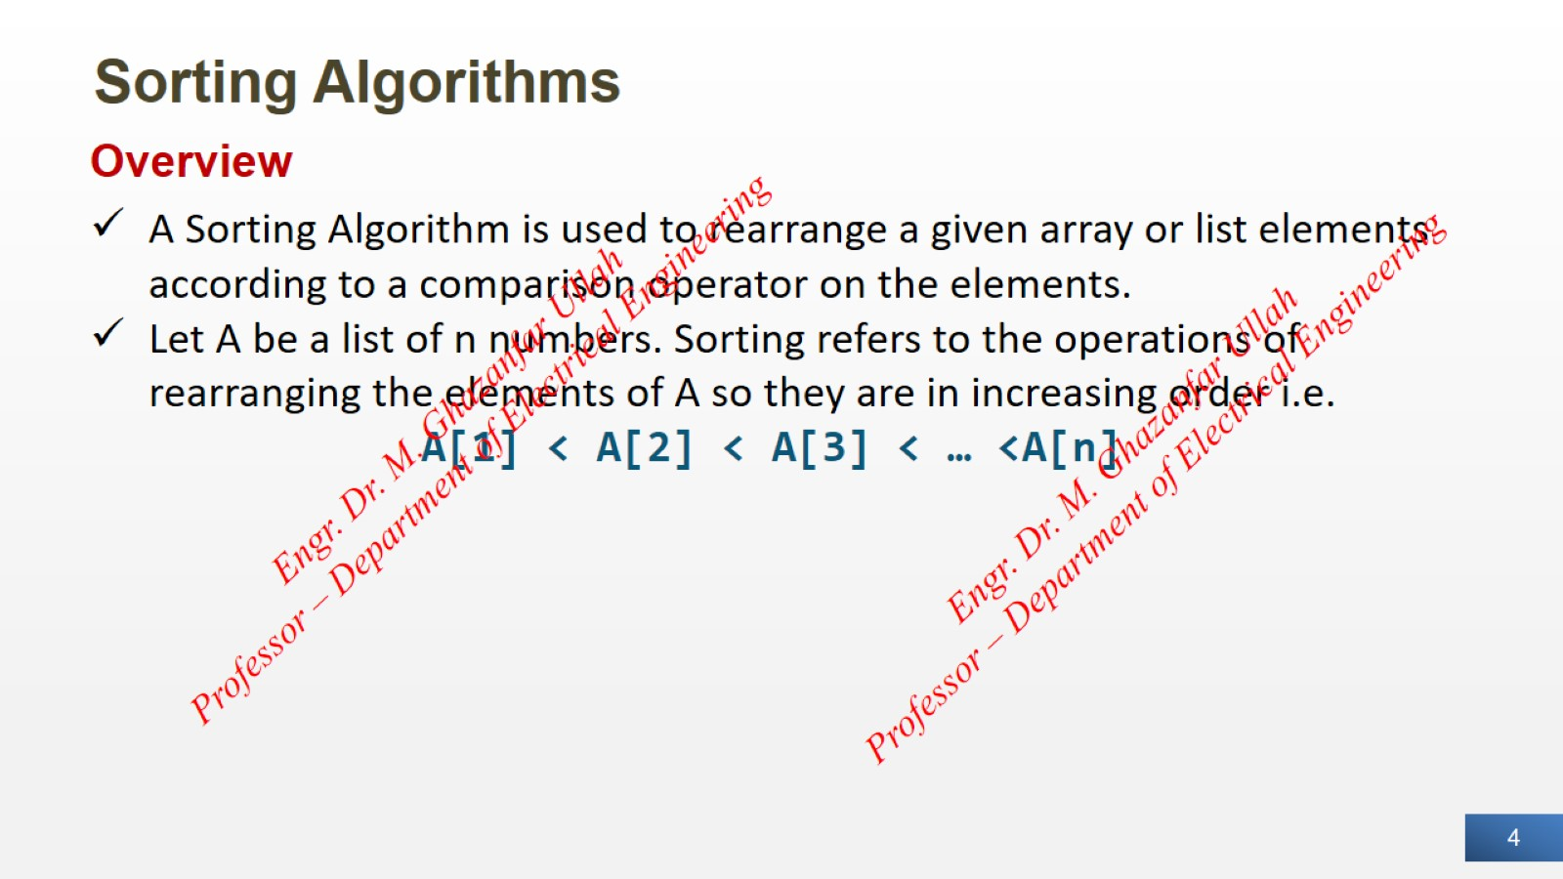
Sorting Algorithms

Slide 5
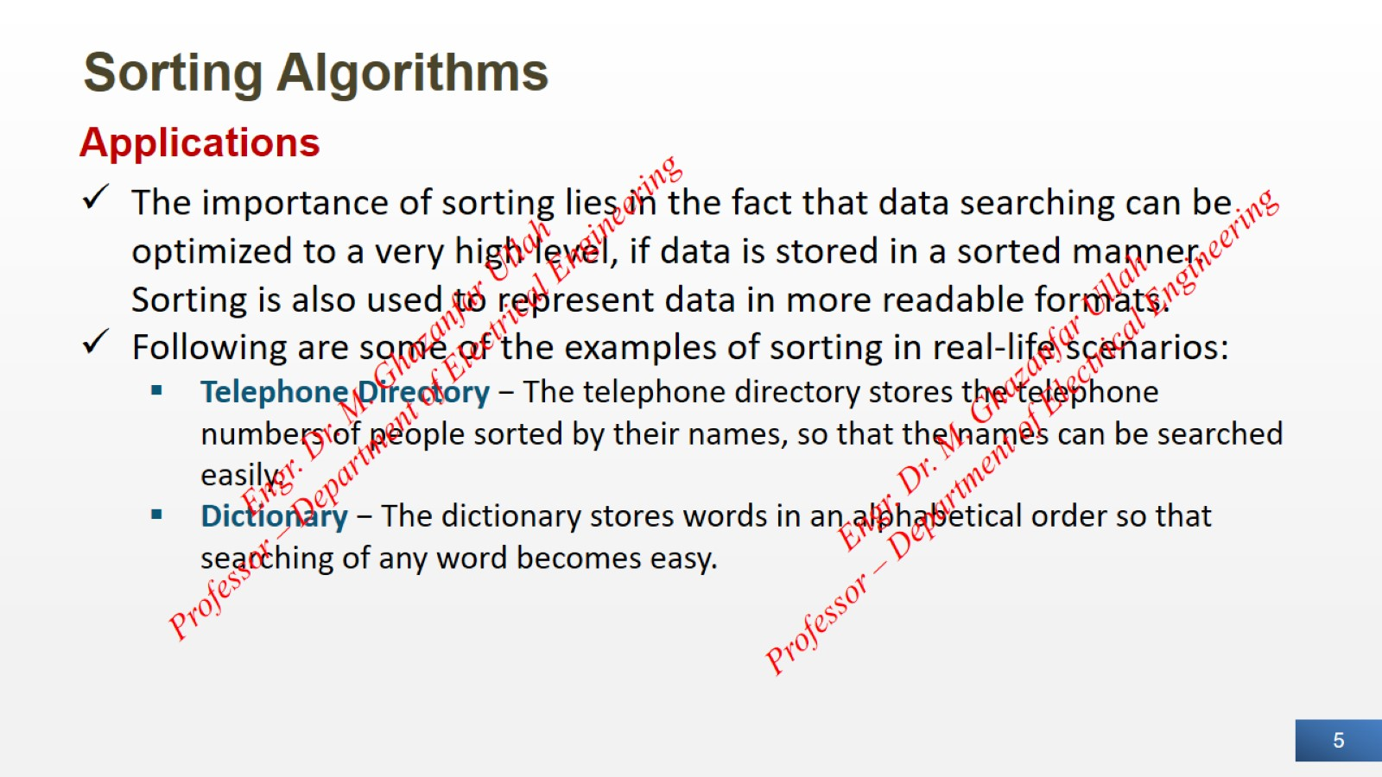
Sorting Algorithms

Slide 6
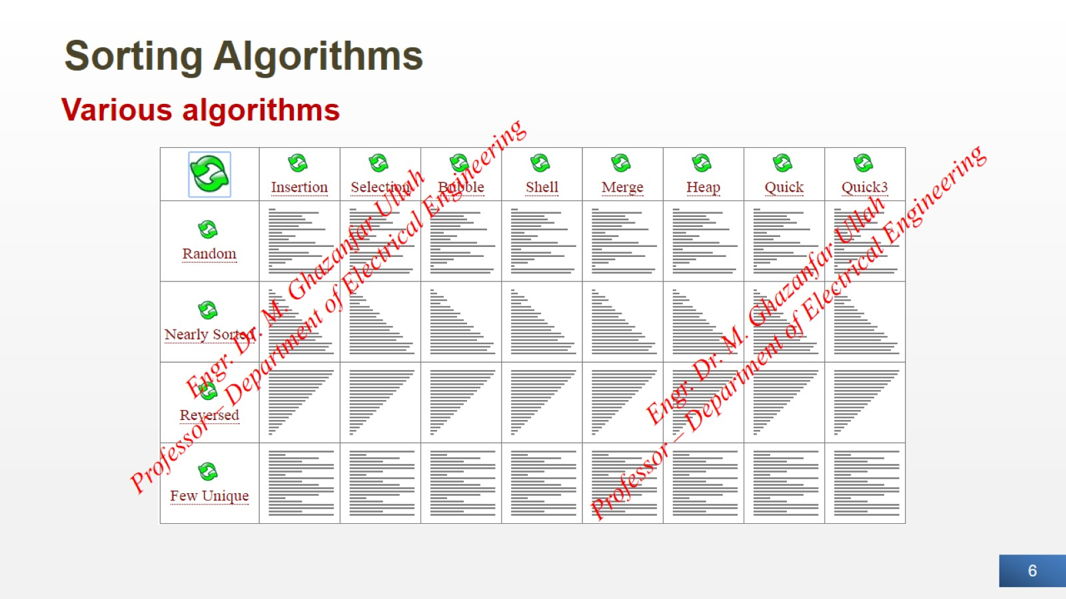
Sorting Algorithms

Slide 7


Slide 8
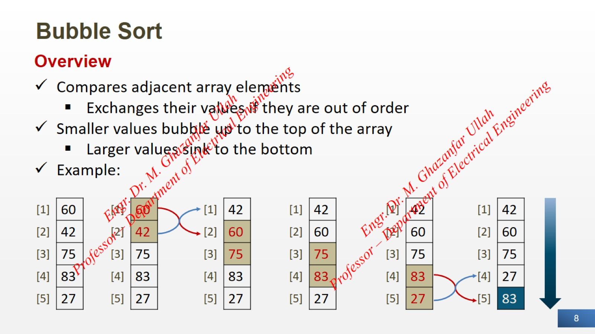
Bubble Sort

Slide 9
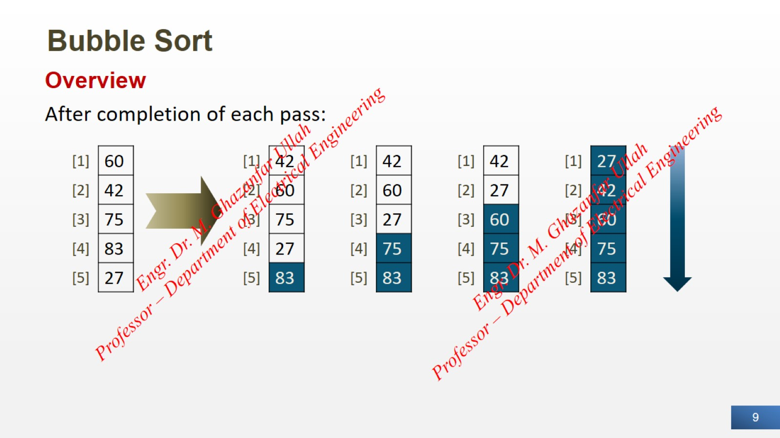
Bubble Sort

Slide 10
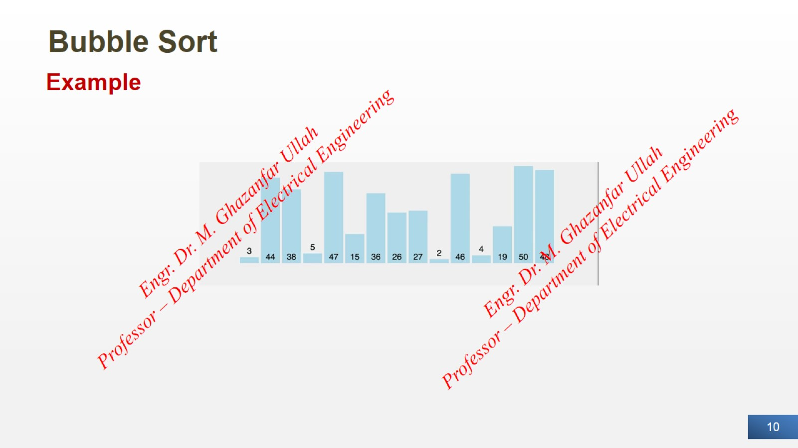
Bubble Sort

Slide 11
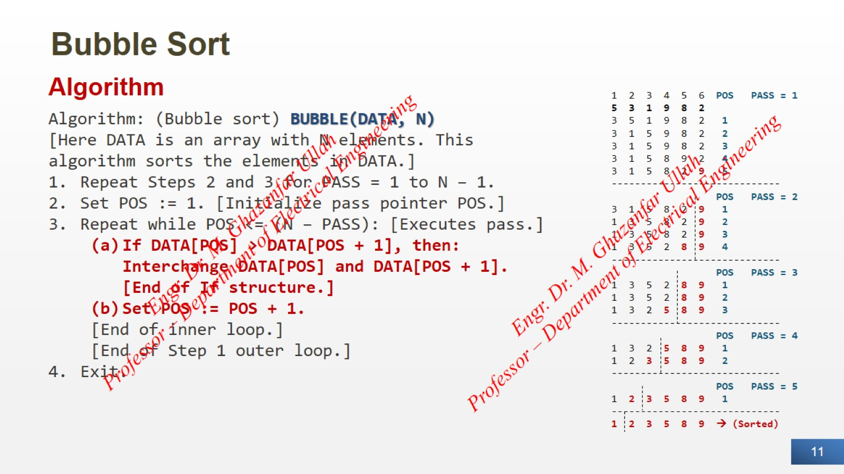
Bubble Sort

Slide 12
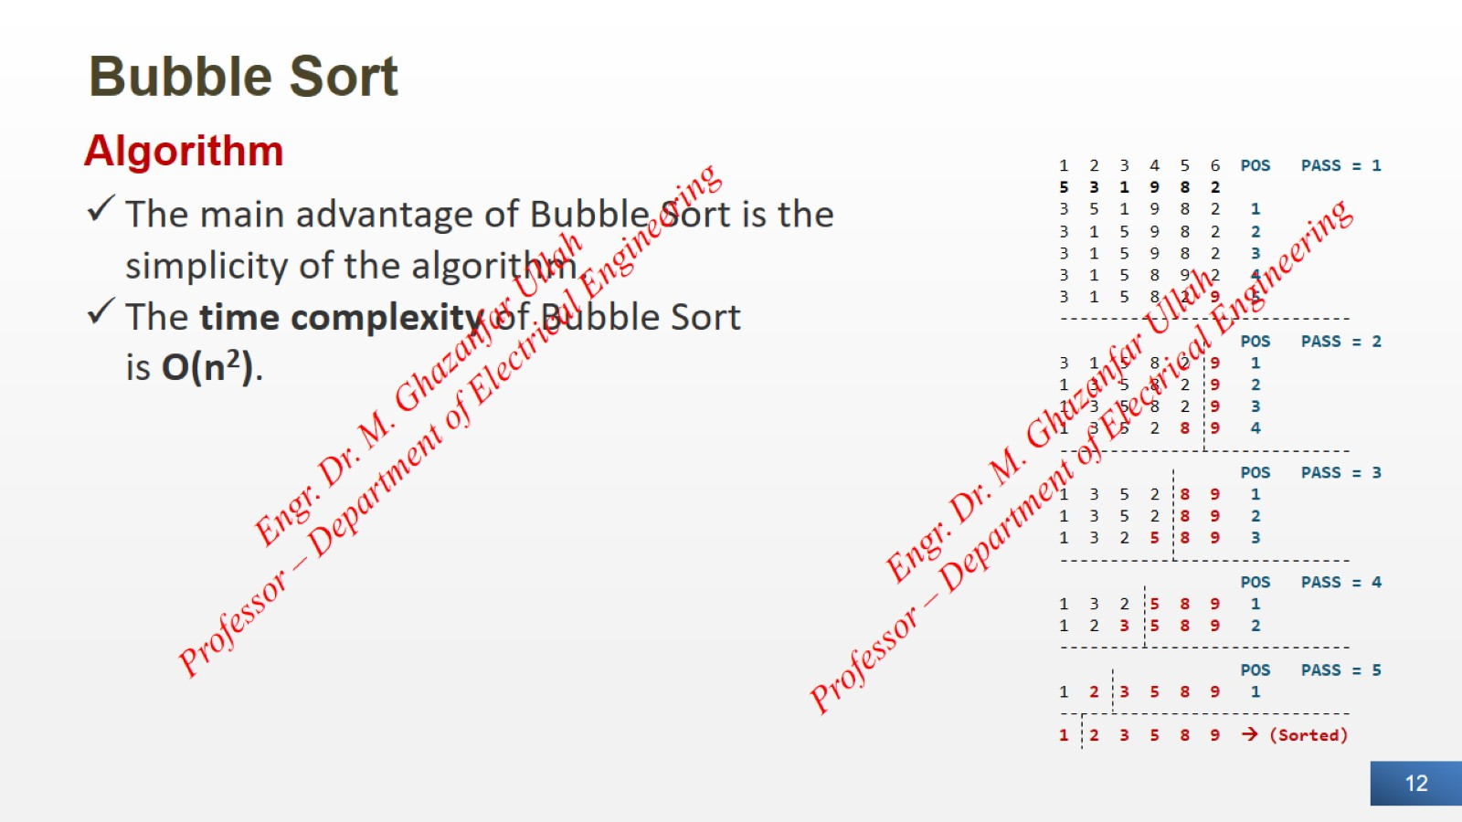
Bubble Sort

Slide 13
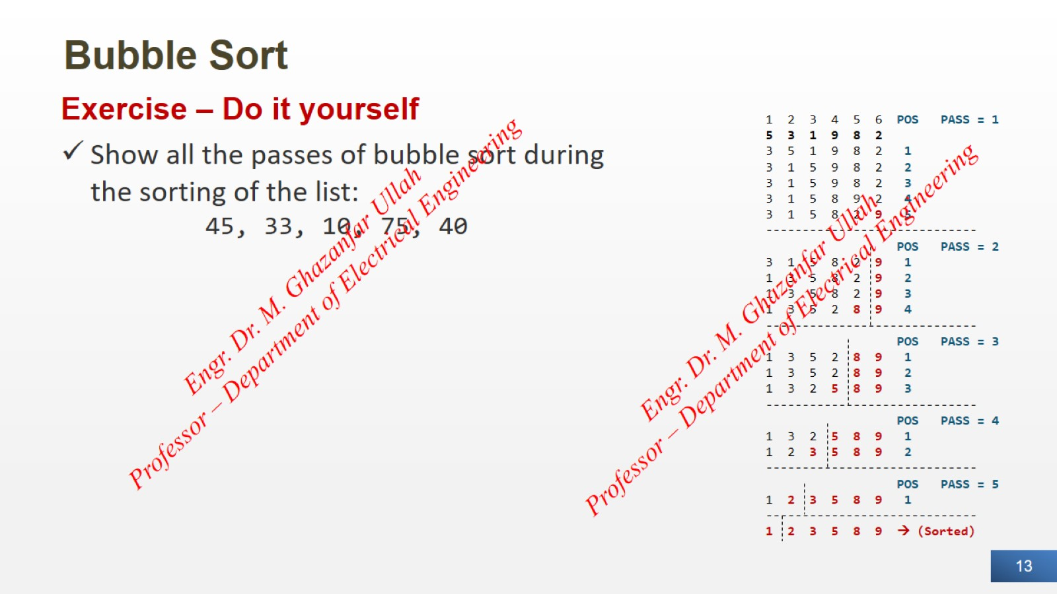
Bubble Sort

Slide 14


Slide 15
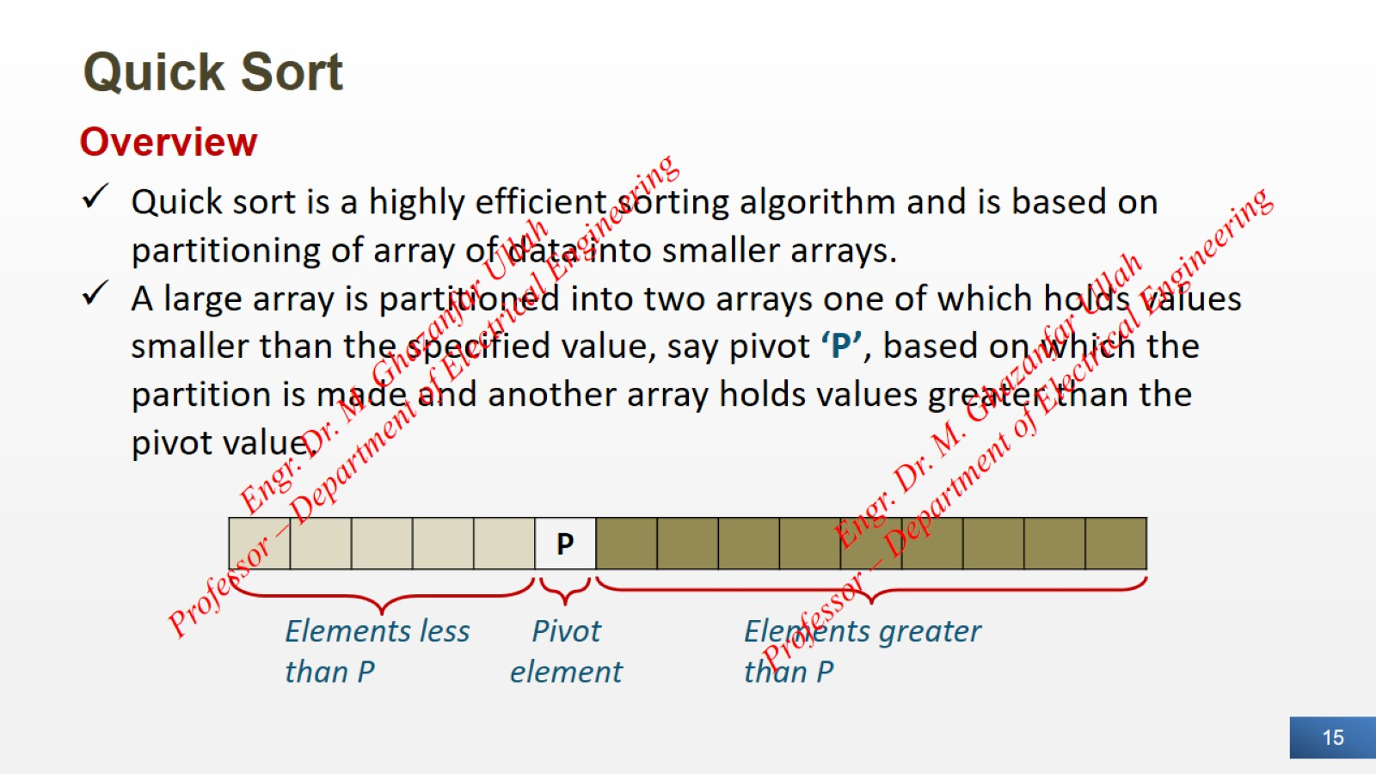
Quick Sort

Slide 16
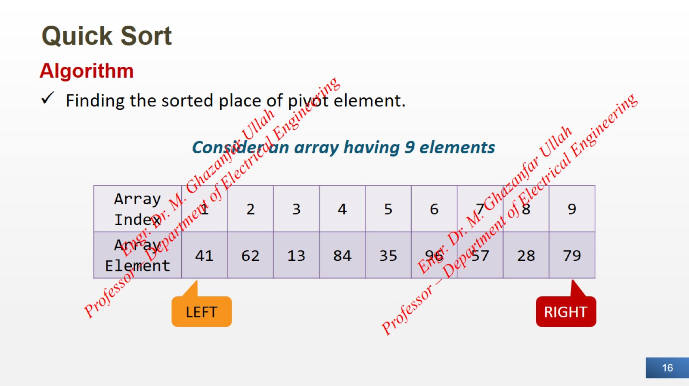
Quick Sort

Slide 17
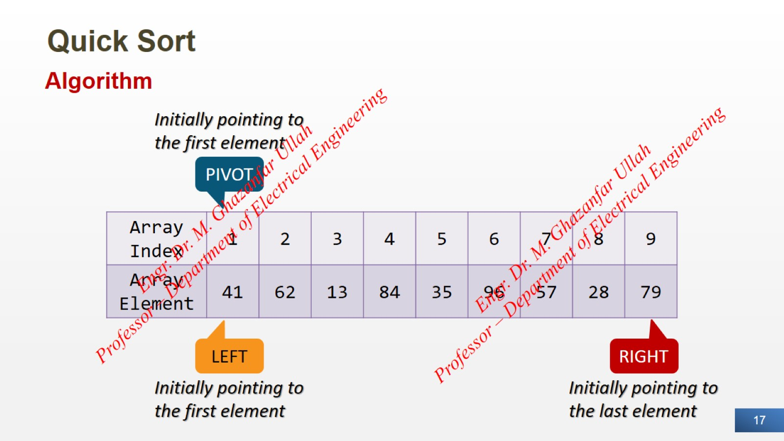
Quick Sort

Slide 18
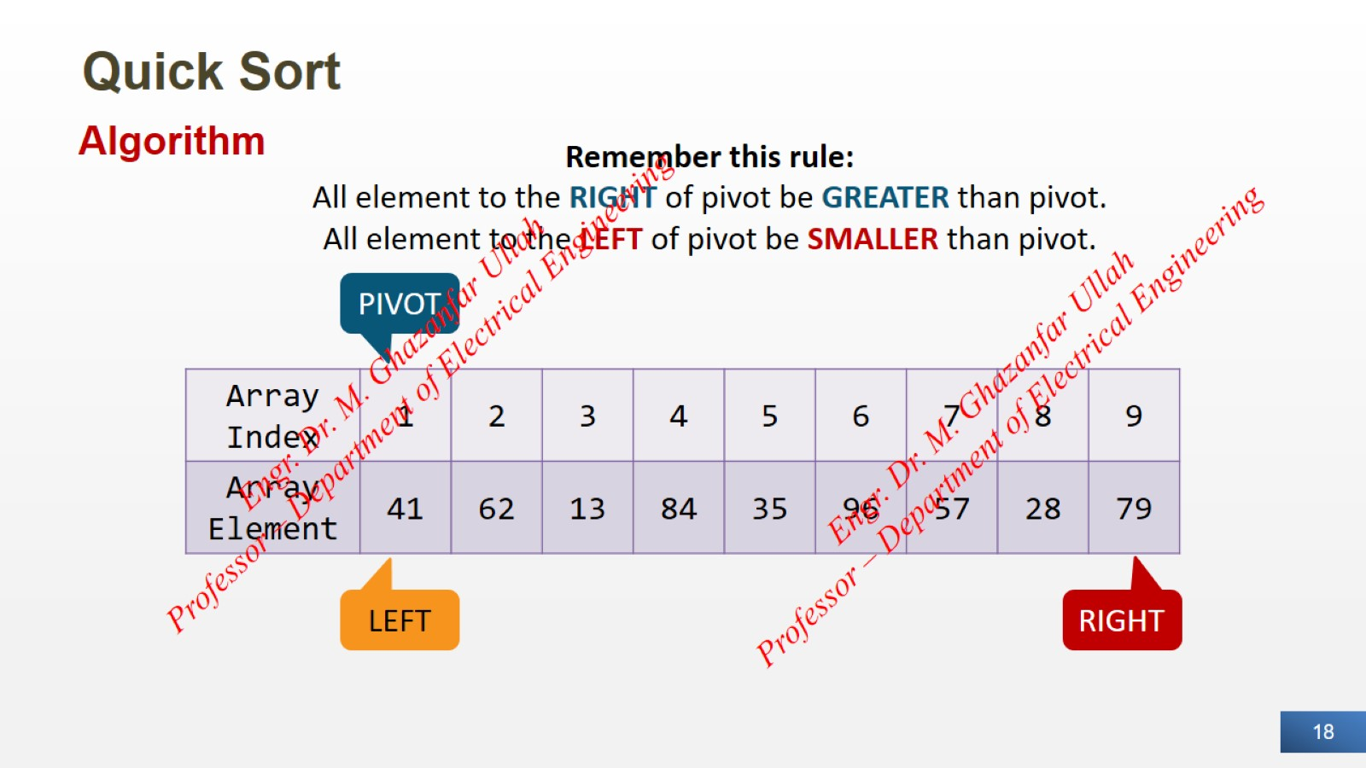
Quick Sort

Slide 19
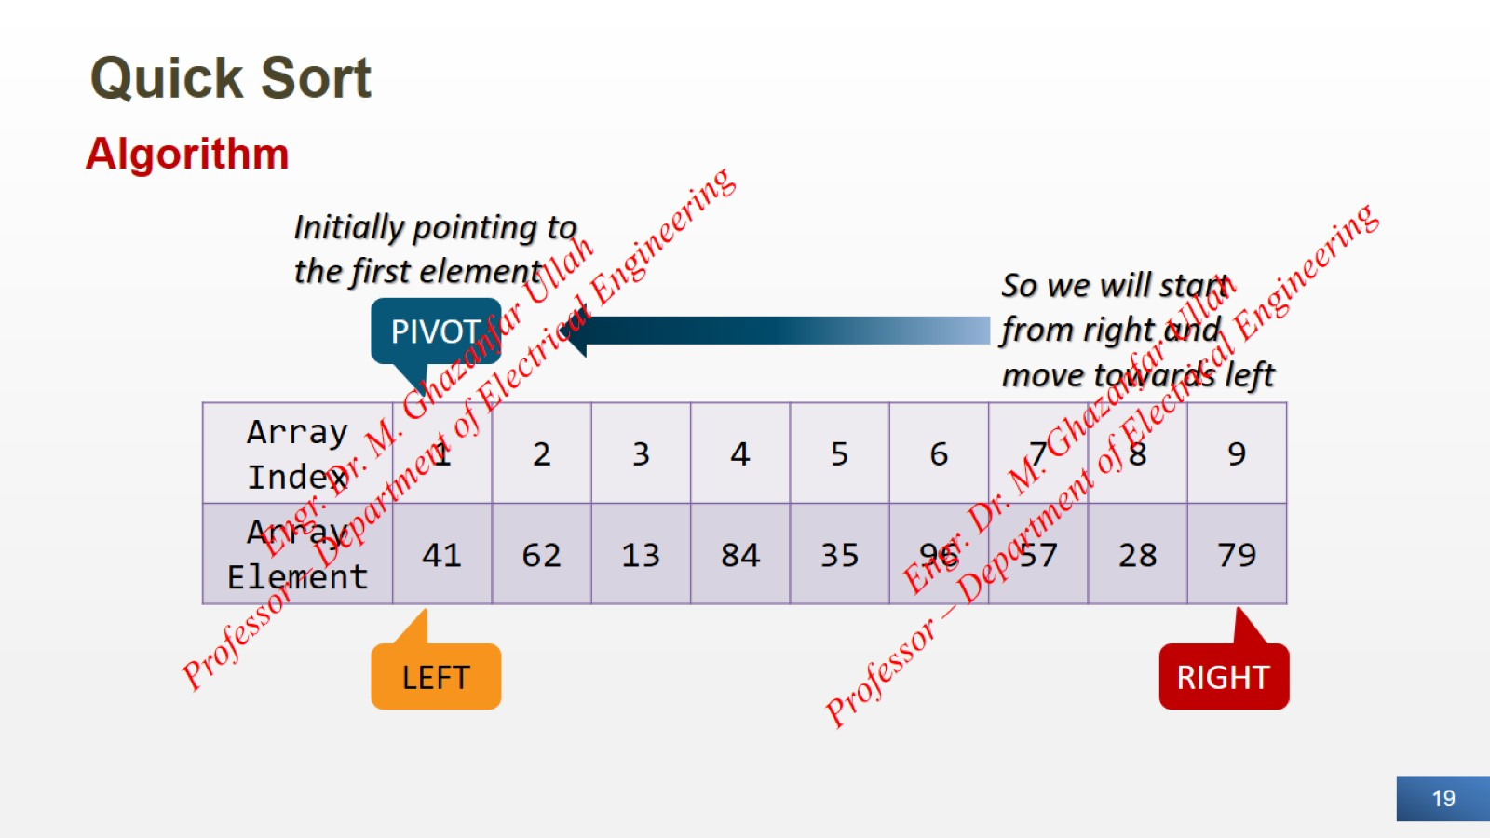
Quick Sort

Slide 20
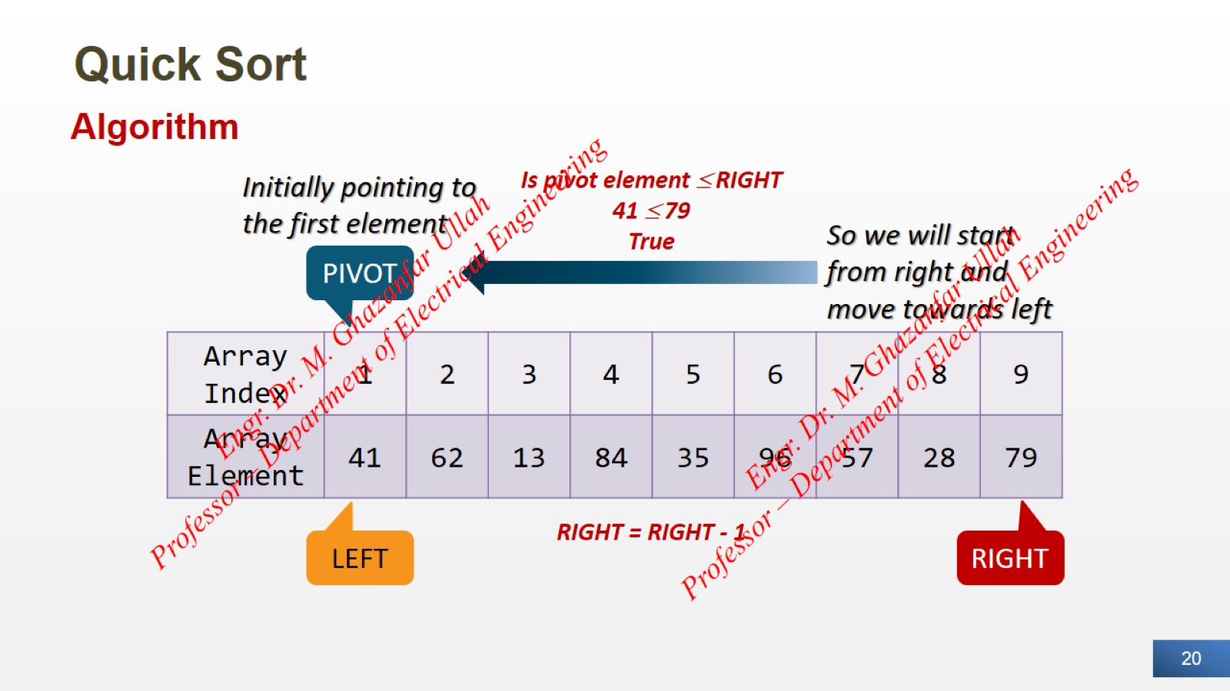
Quick Sort

Slide 21
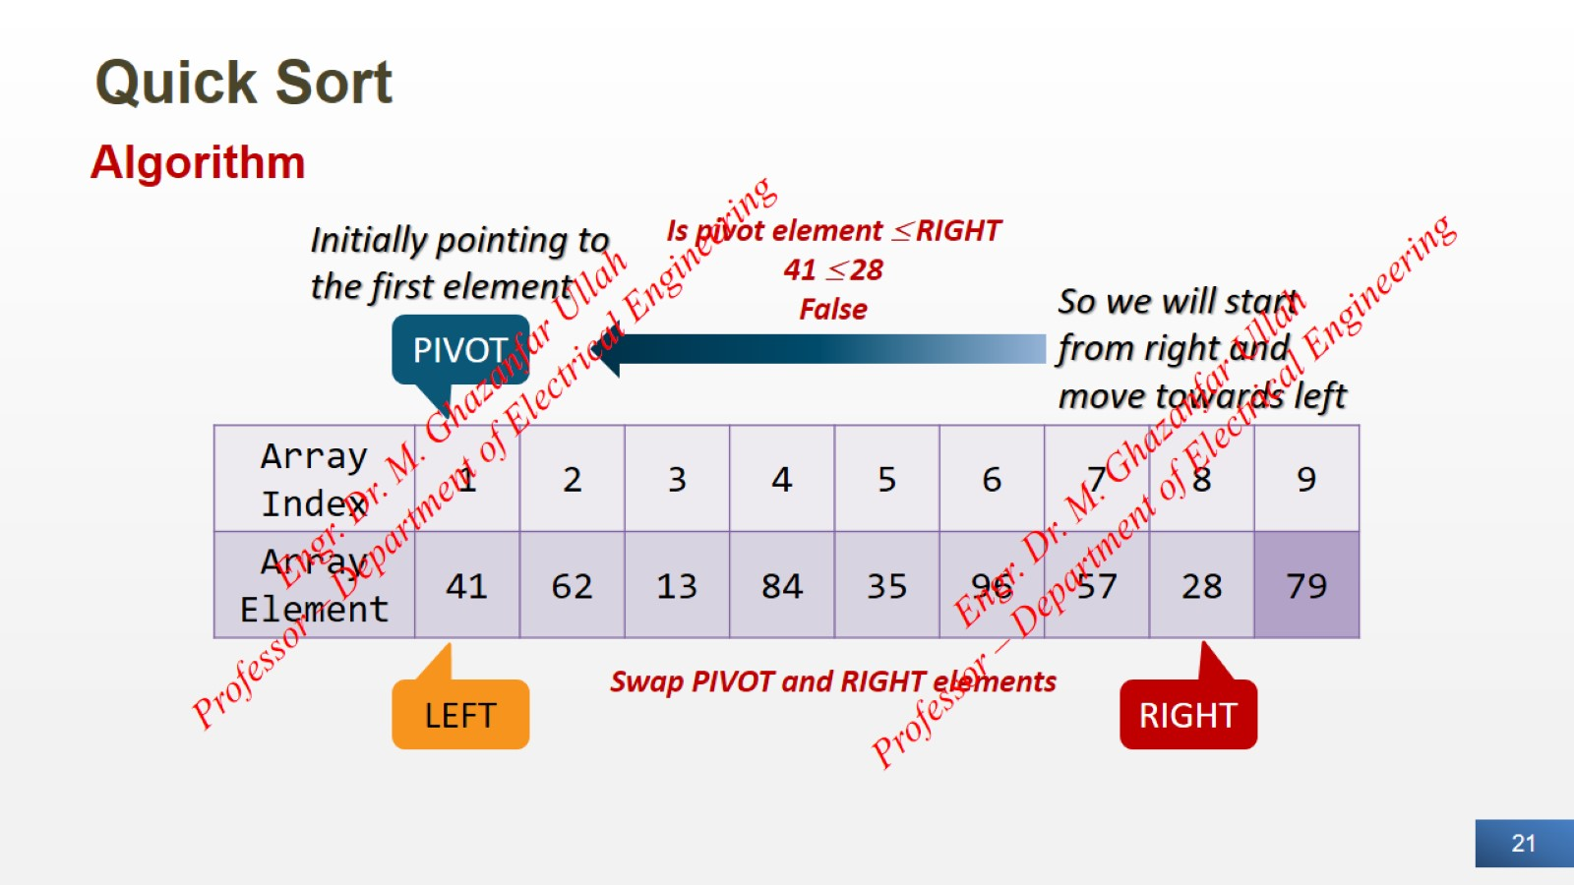
Quick Sort

Slide 22
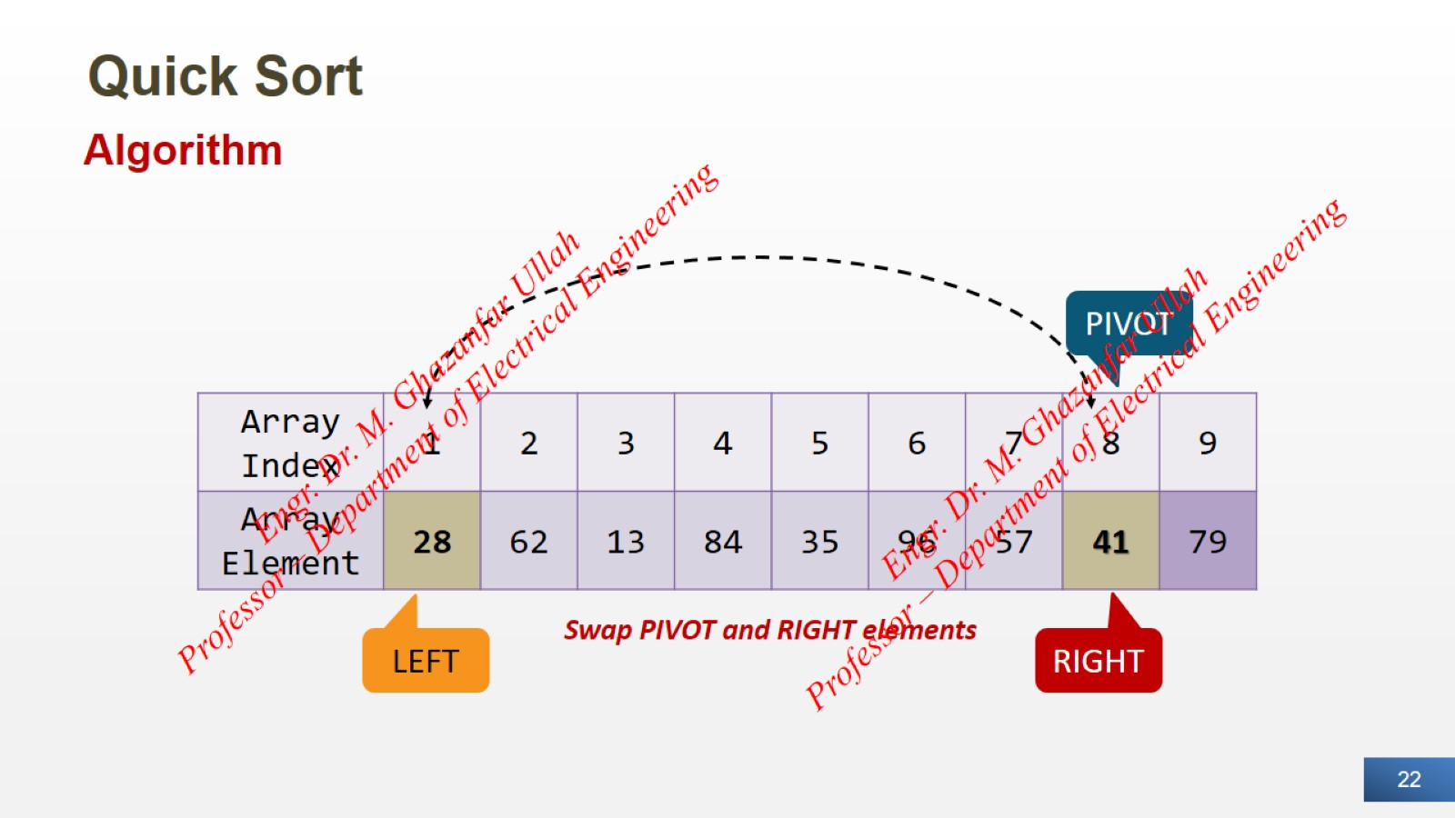
Quick Sort

Slide 23
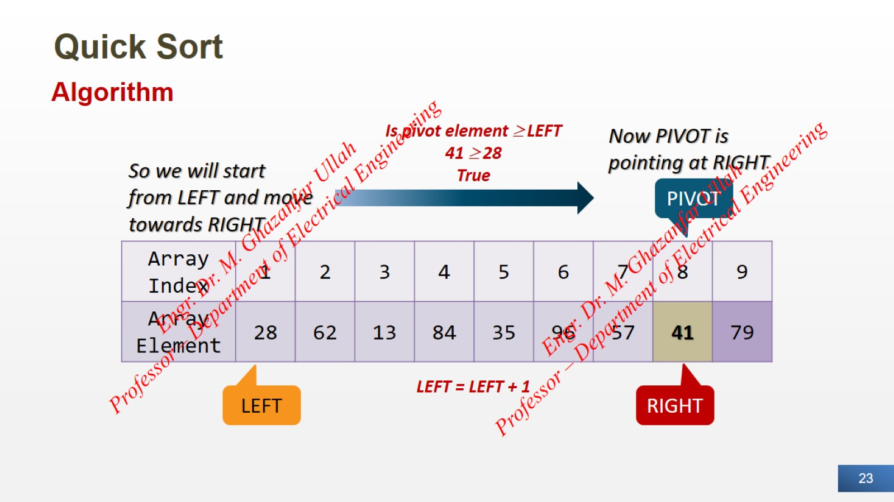
Quick Sort

Slide 24
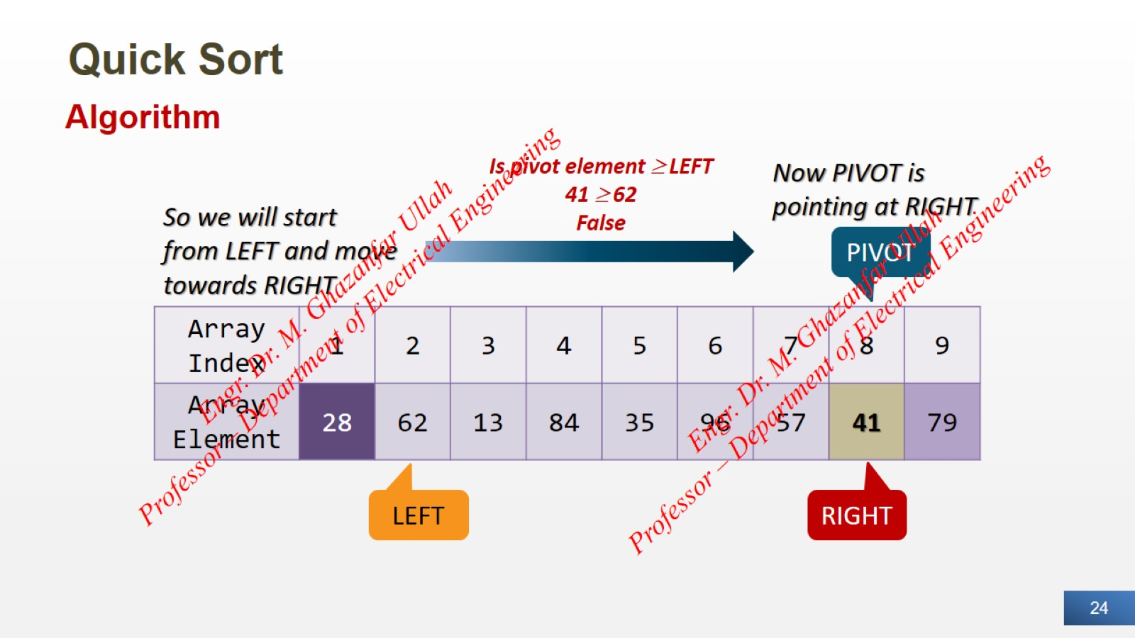
Quick Sort

Slide 25
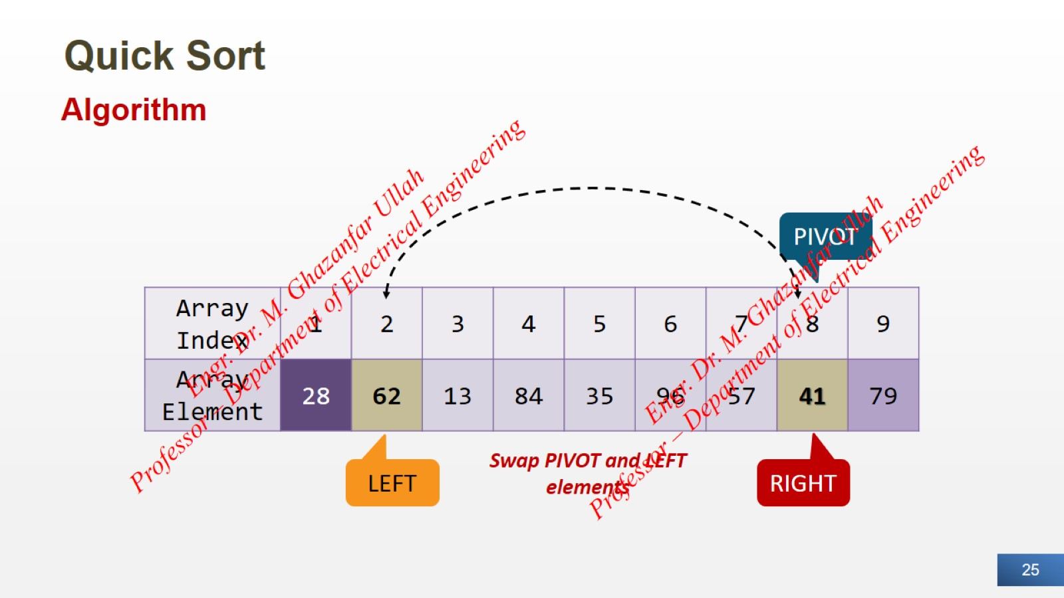
Quick Sort

Slide 26
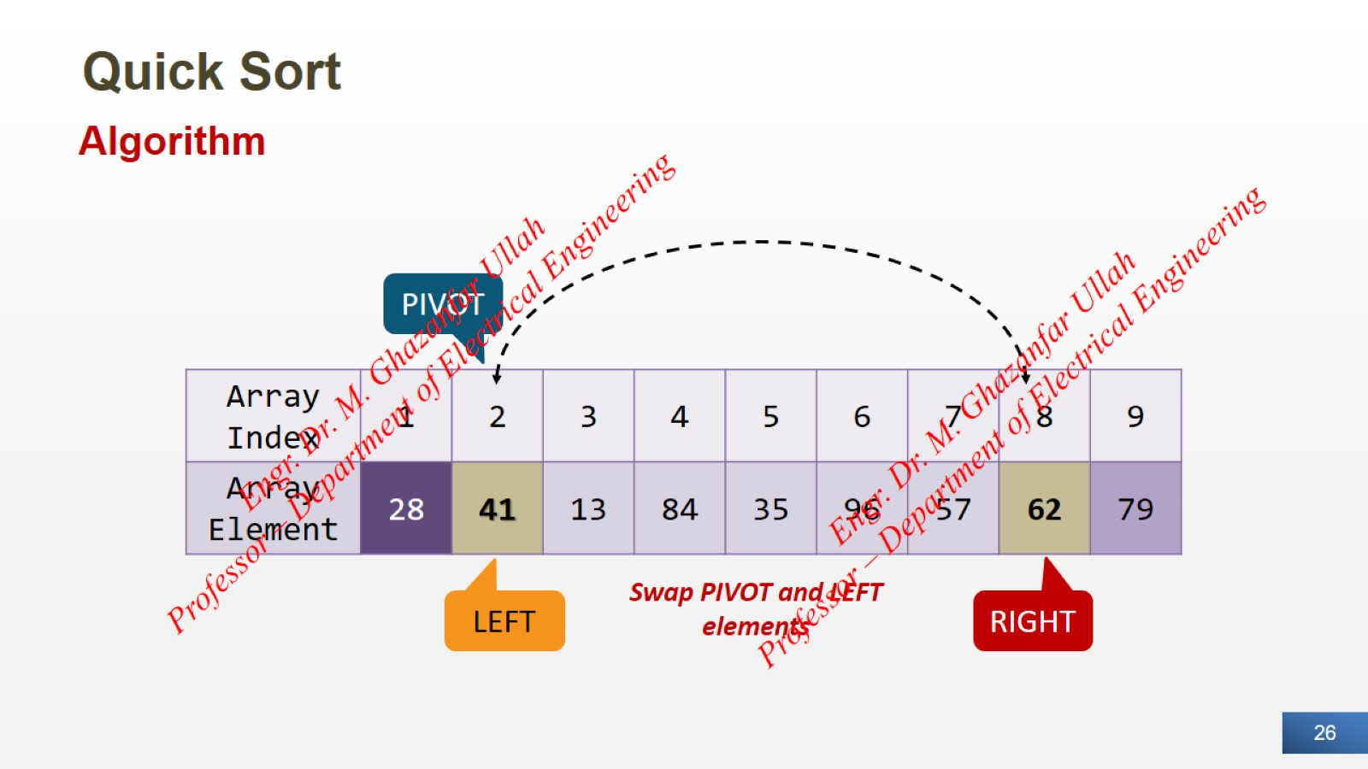
Quick Sort

Slide 27
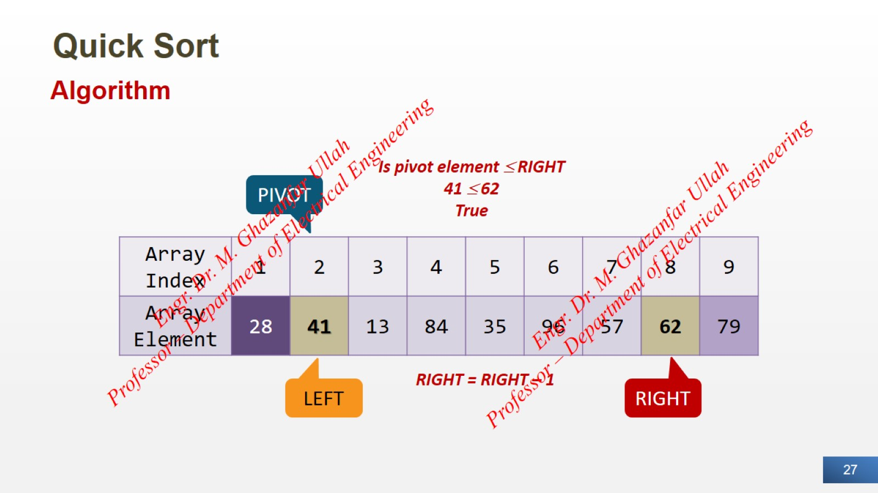
Quick Sort

Slide 28
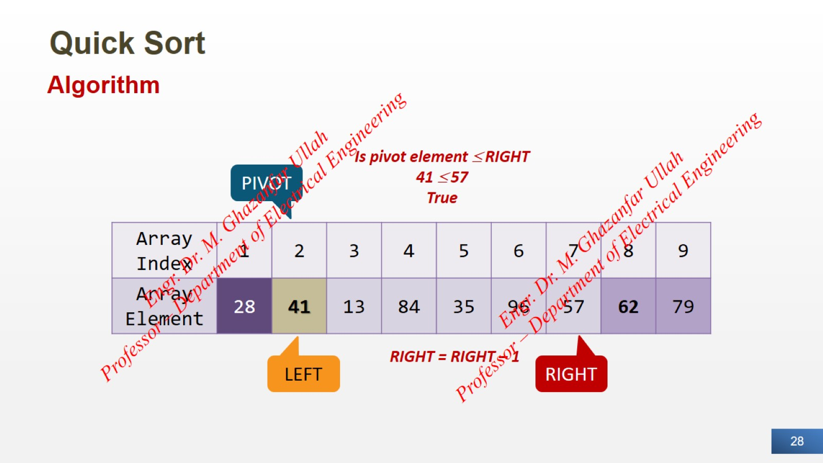
Quick Sort

Slide 29
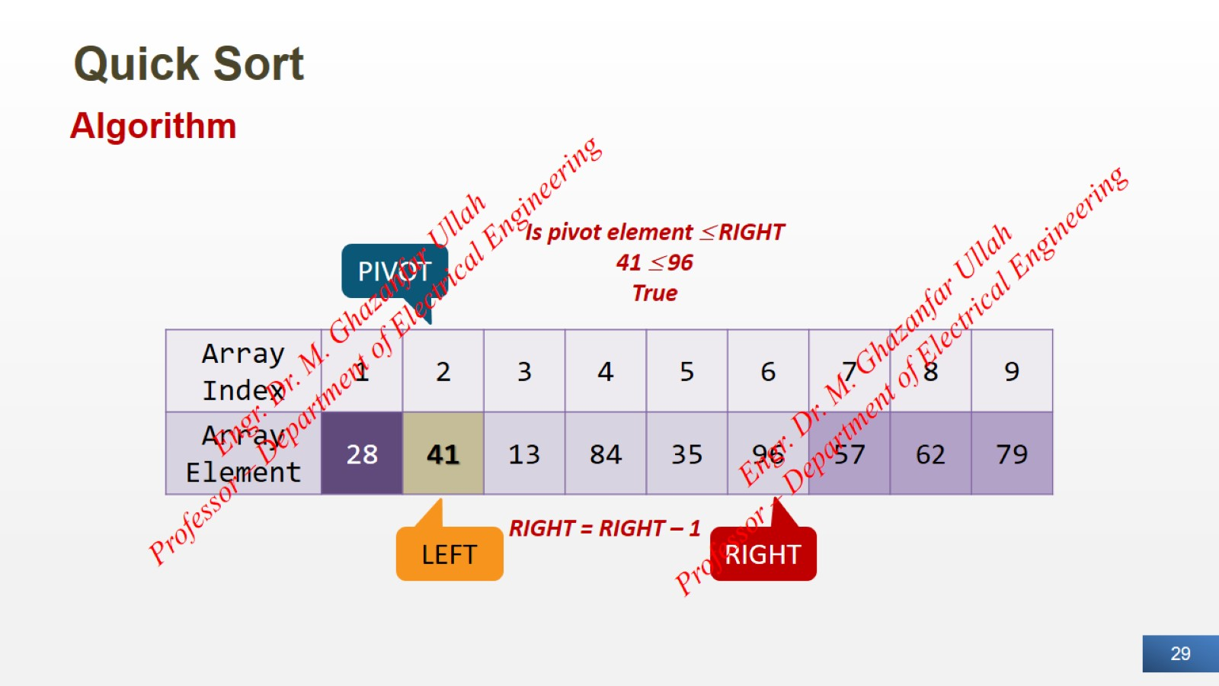
Quick Sort

Slide 30
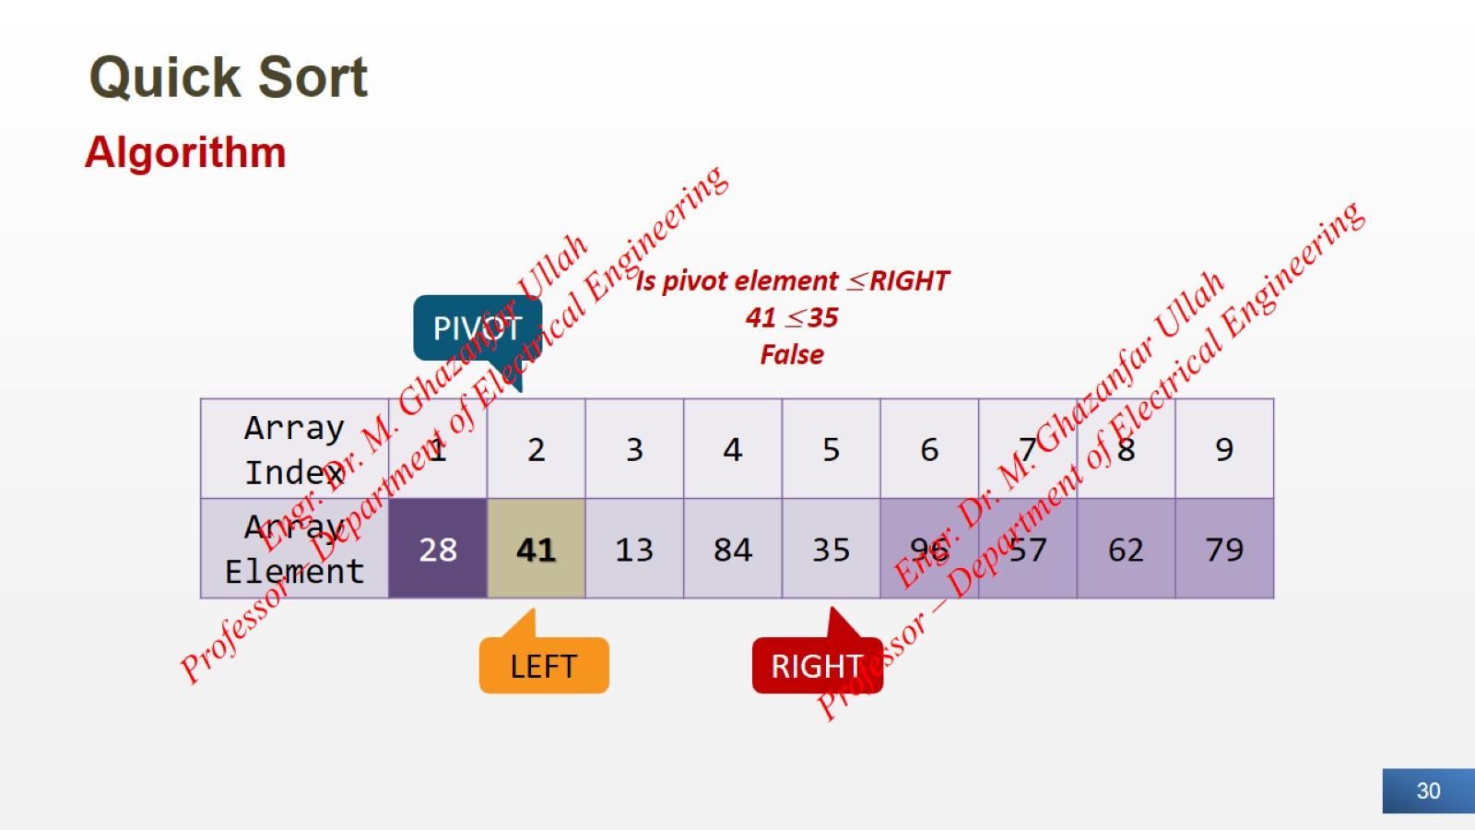
Quick Sort

Slide 31
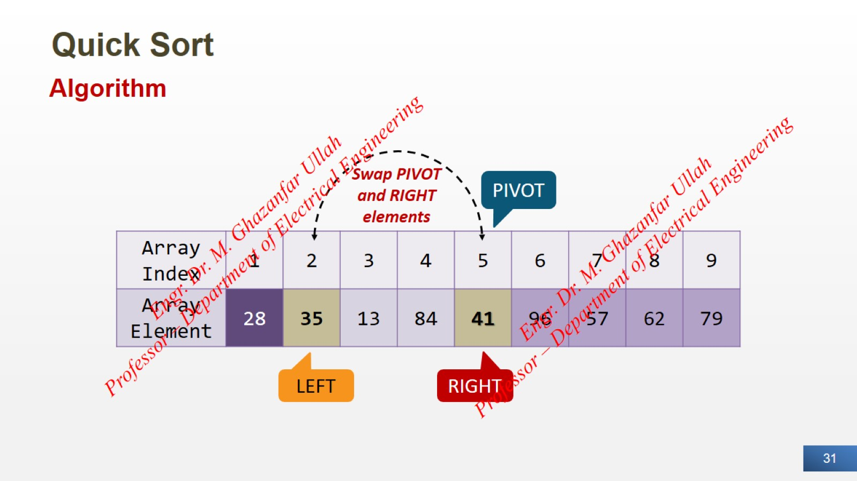
Quick Sort

Slide 32
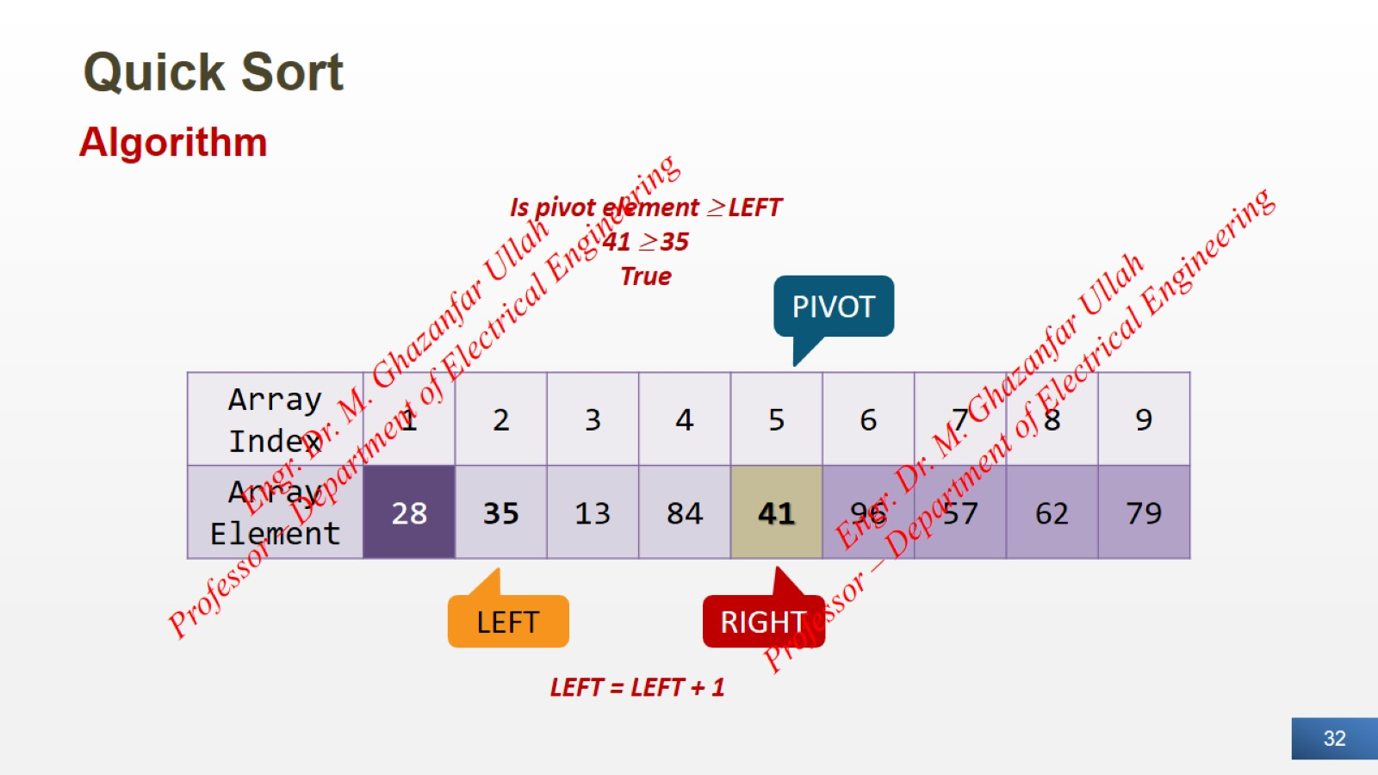
Quick Sort

Slide 33
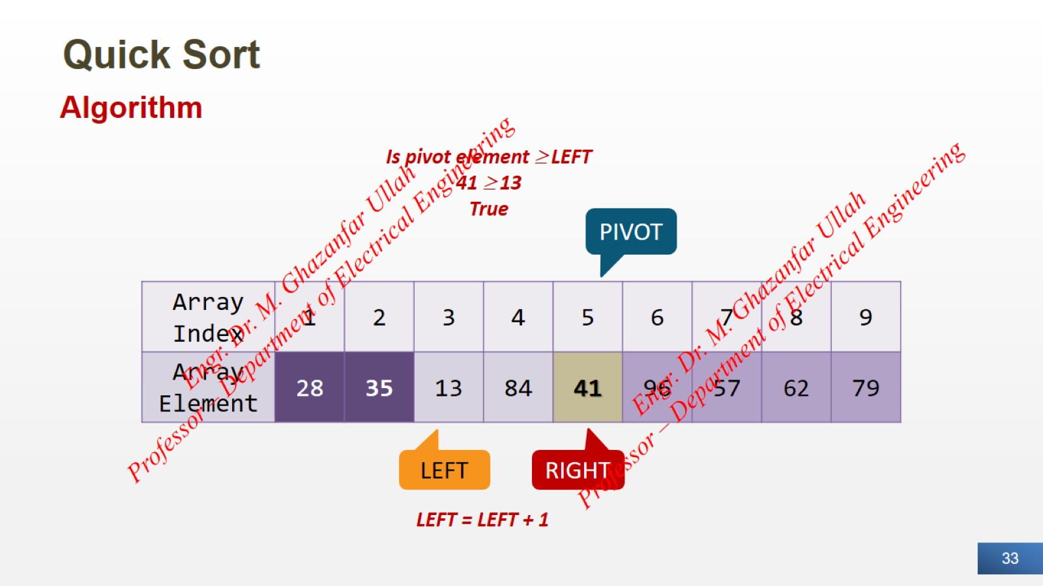
Quick Sort

Slide 34
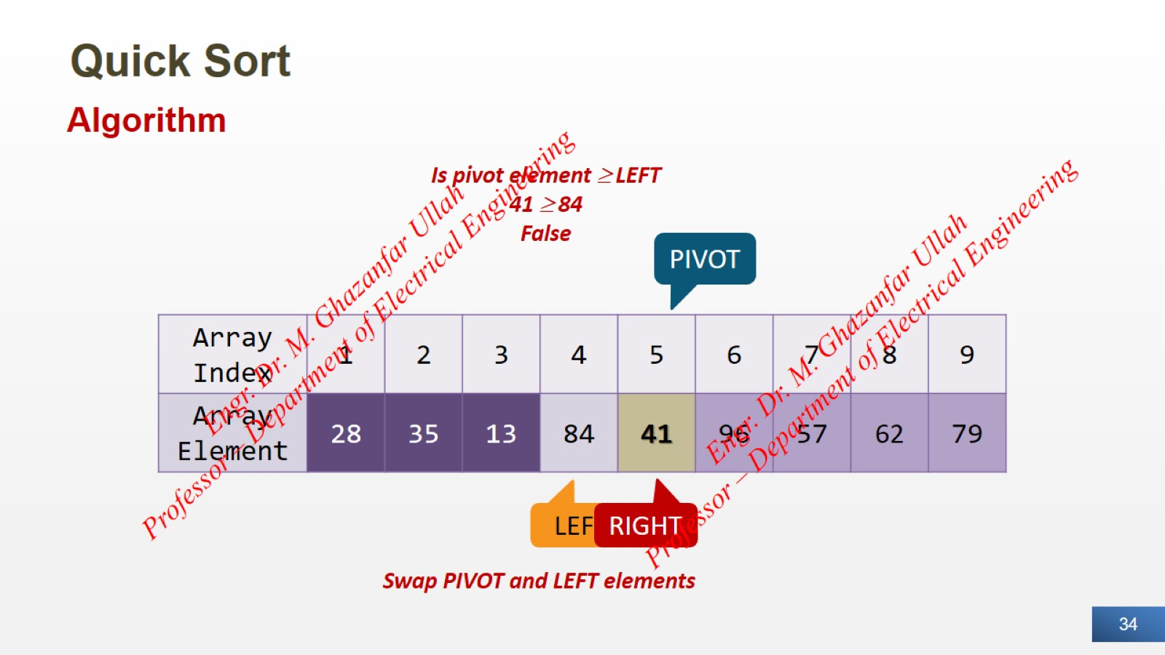
Quick Sort

Slide 35
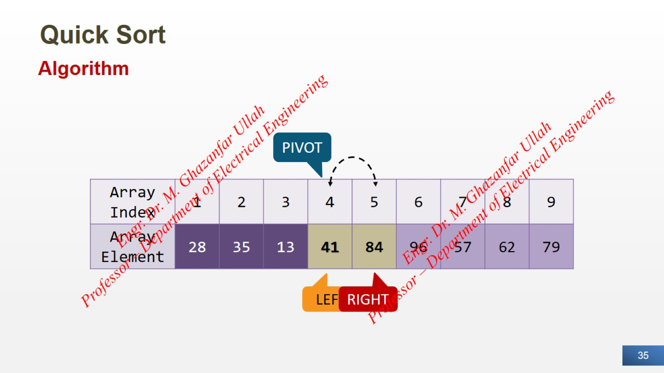
Quick Sort

Slide 36
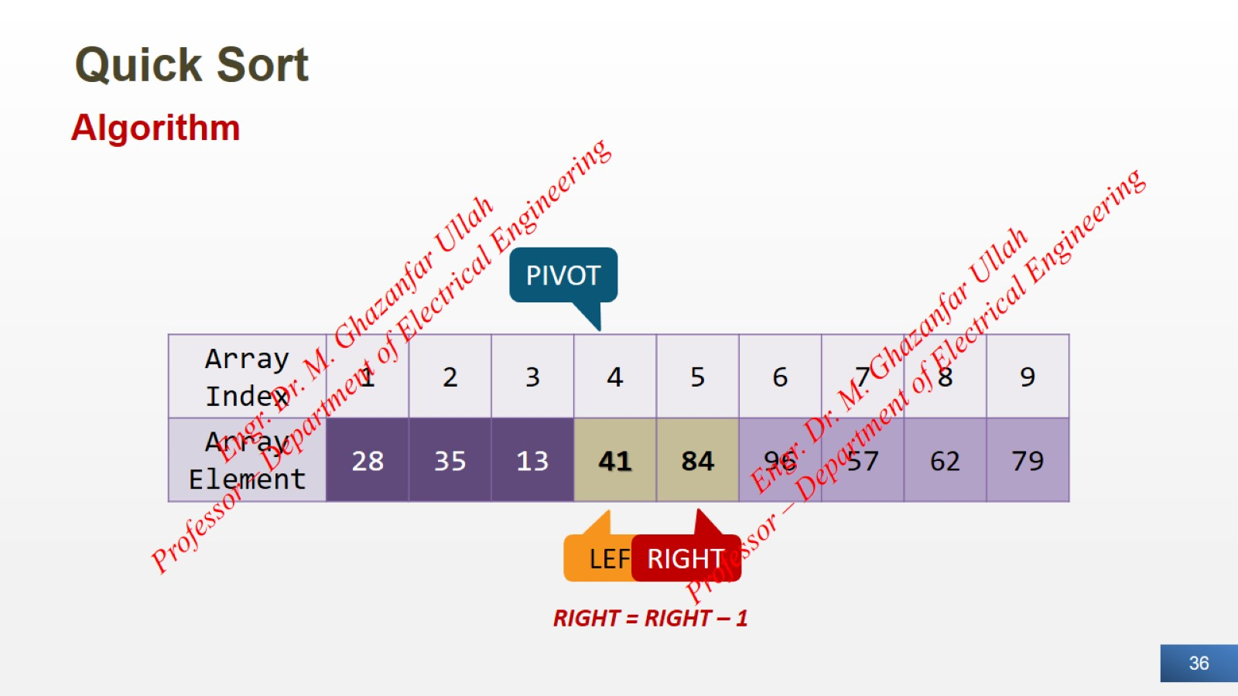
Quick Sort

Slide 37
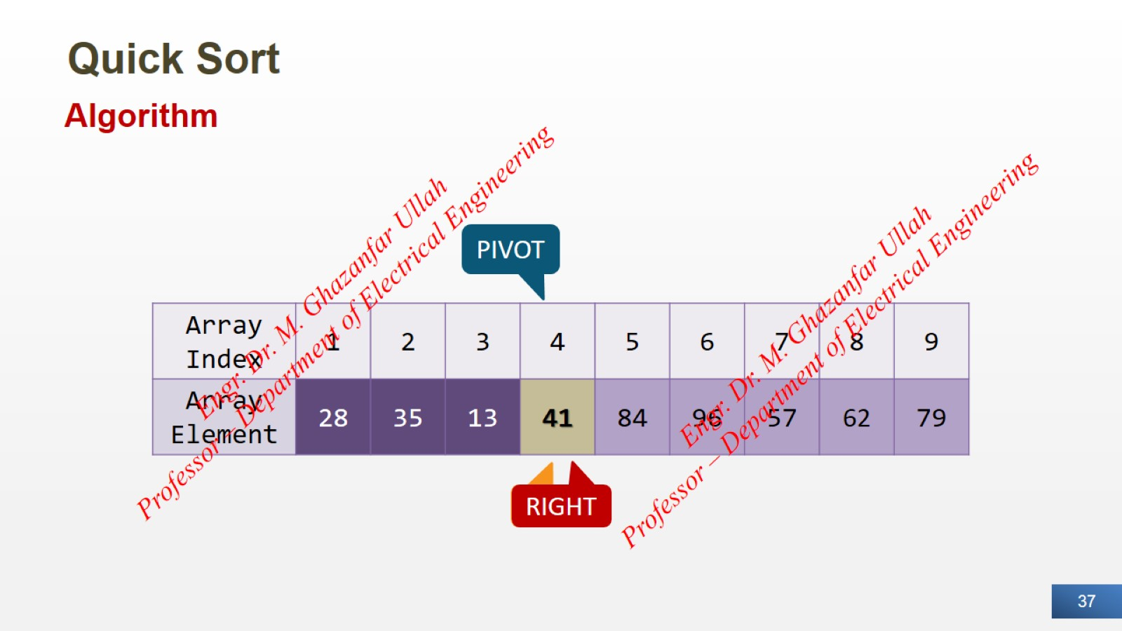
Quick Sort

Slide 38
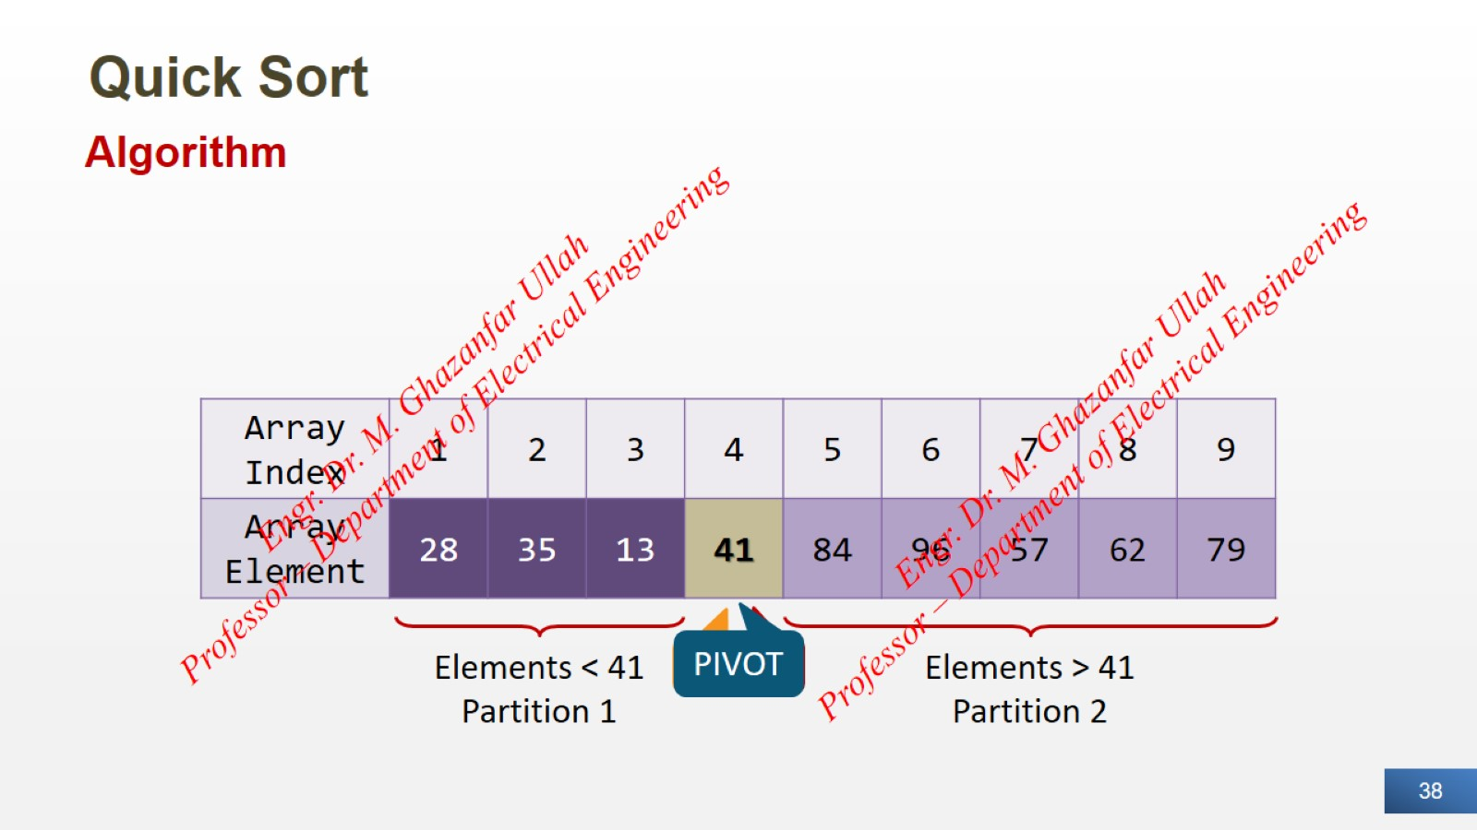
Quick Sort

Slide 39
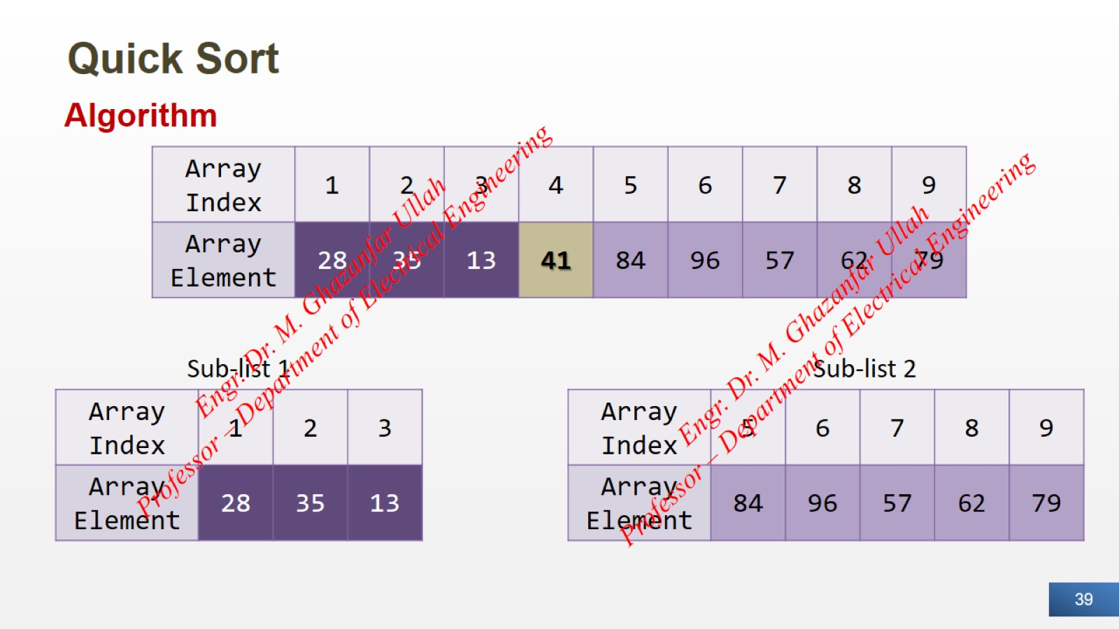
Quick Sort

Slide 40
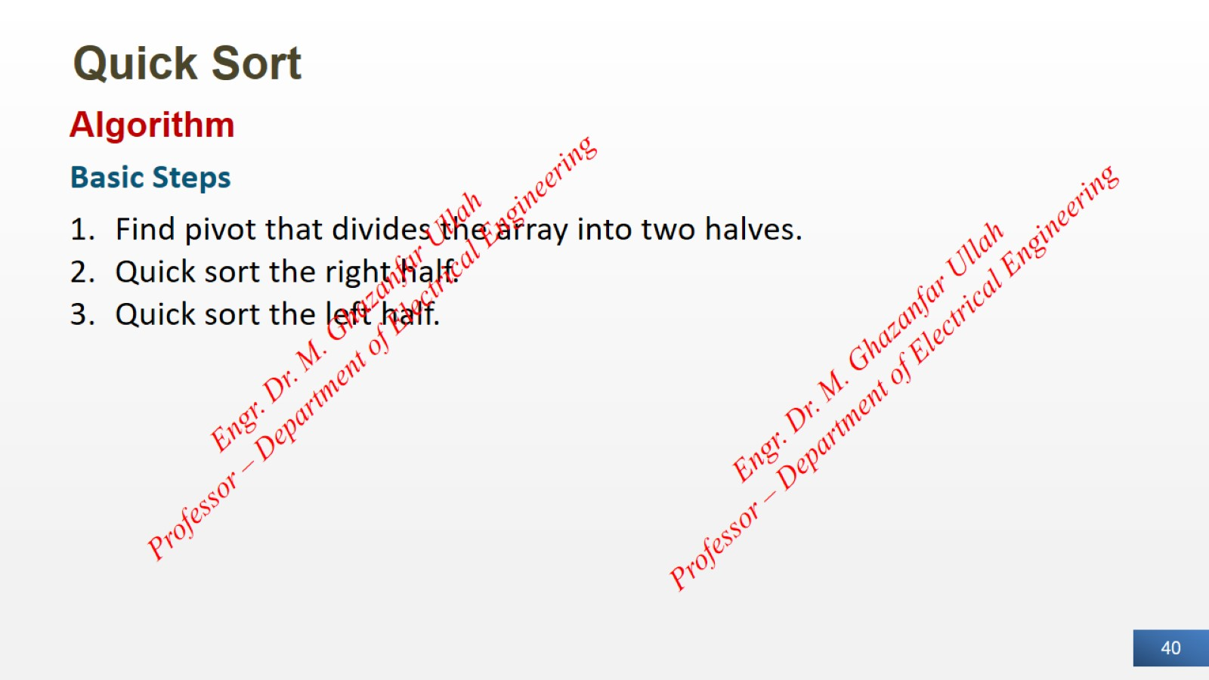
Quick Sort

Slide 41
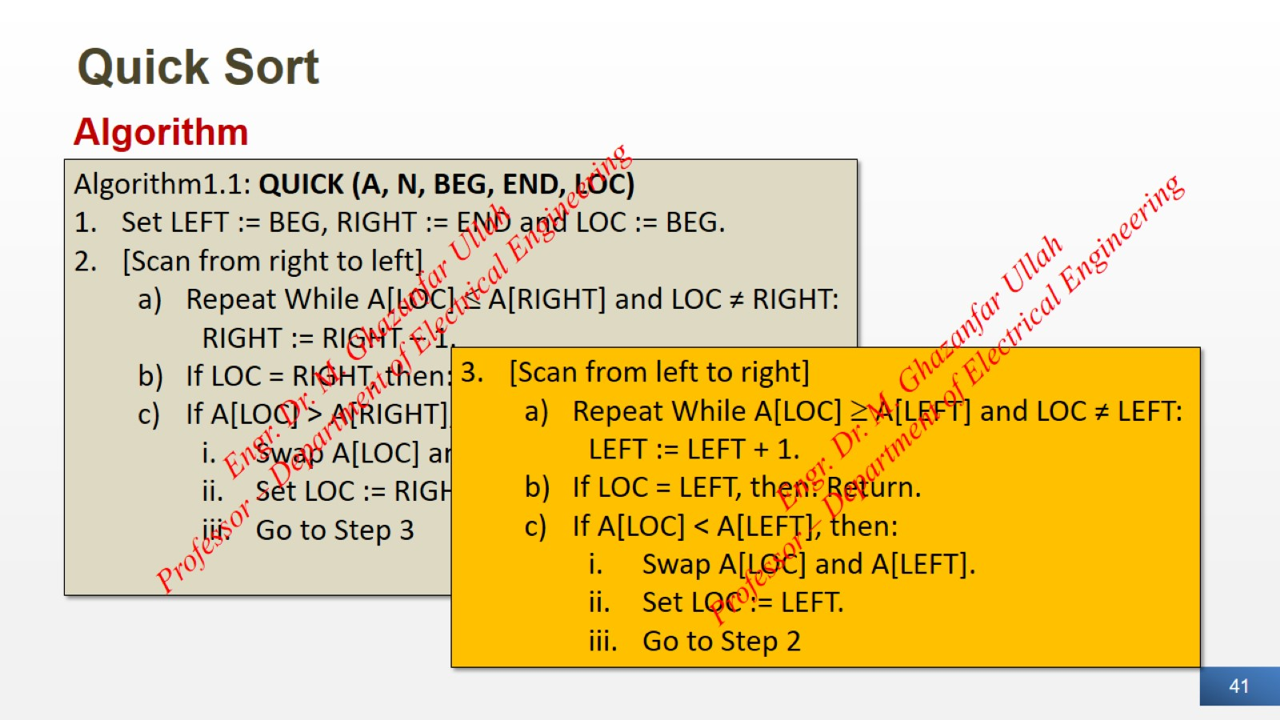
Quick Sort

Slide 42
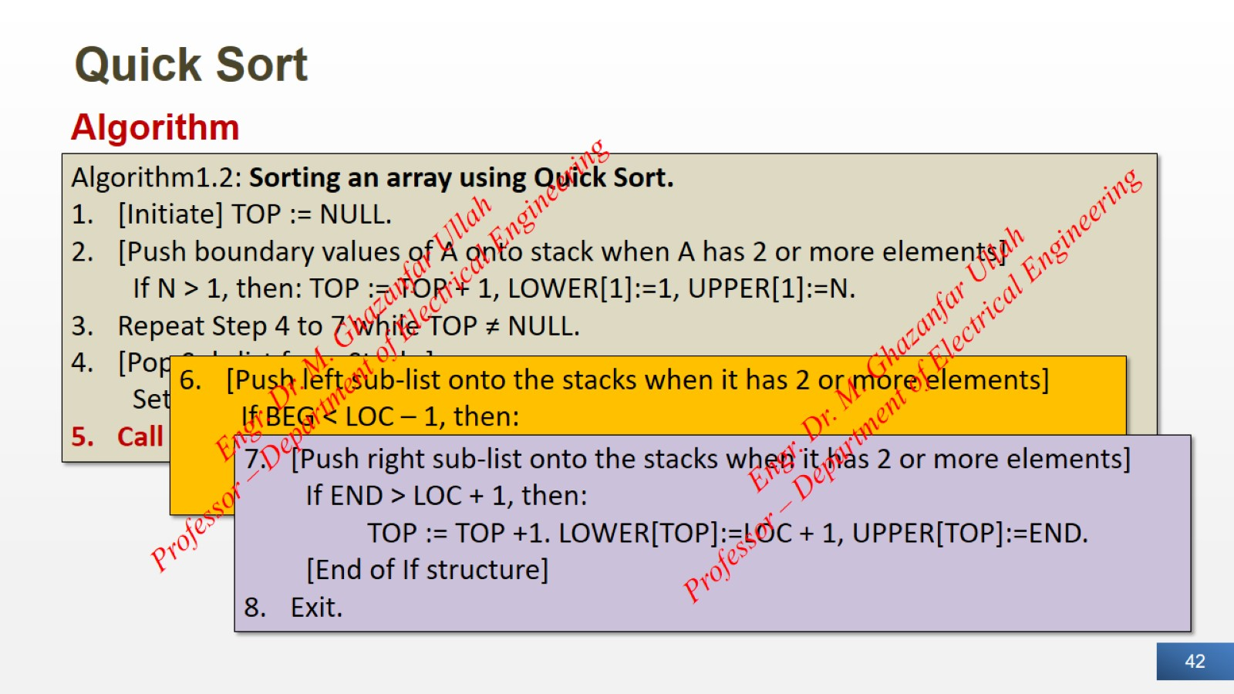
Quick Sort

Slide 43
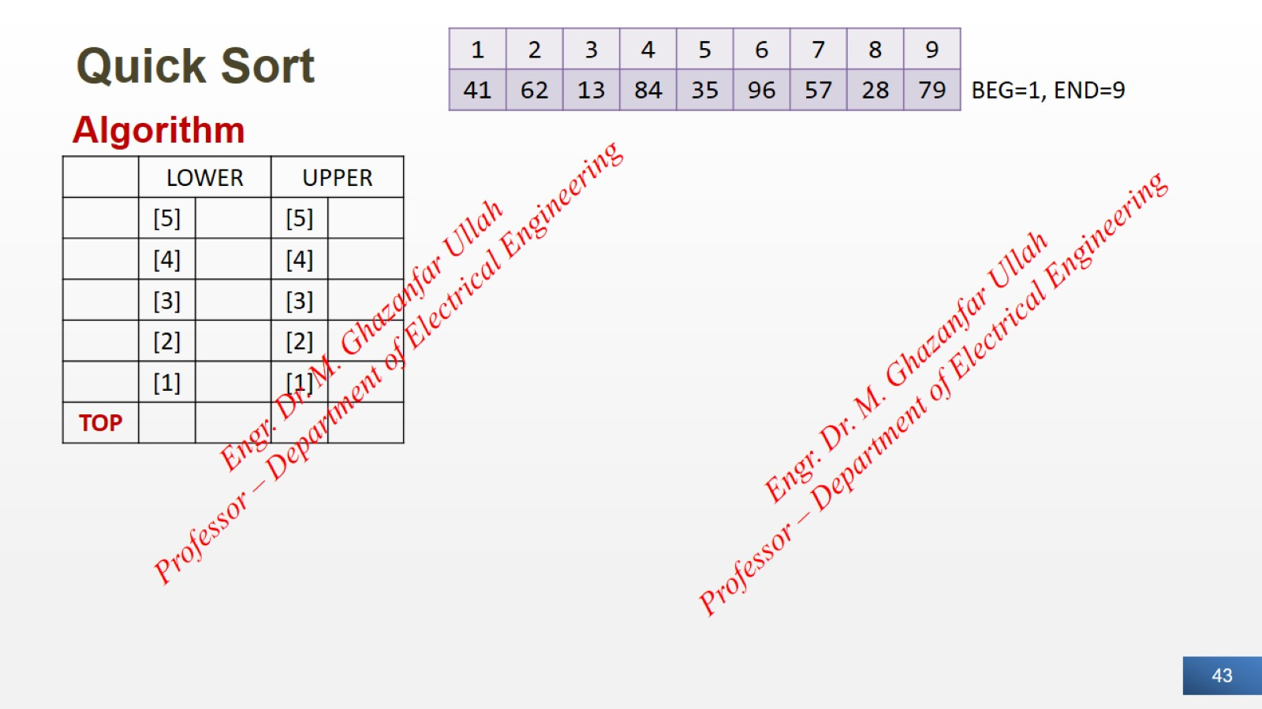
Quick Sort

Slide 44
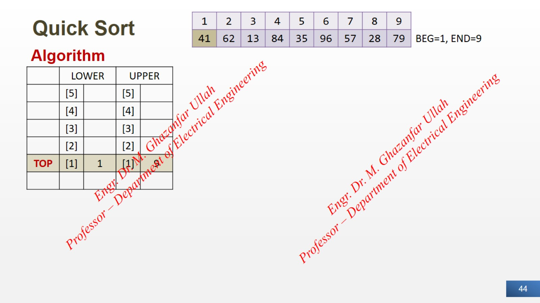
Quick Sort

Slide 45
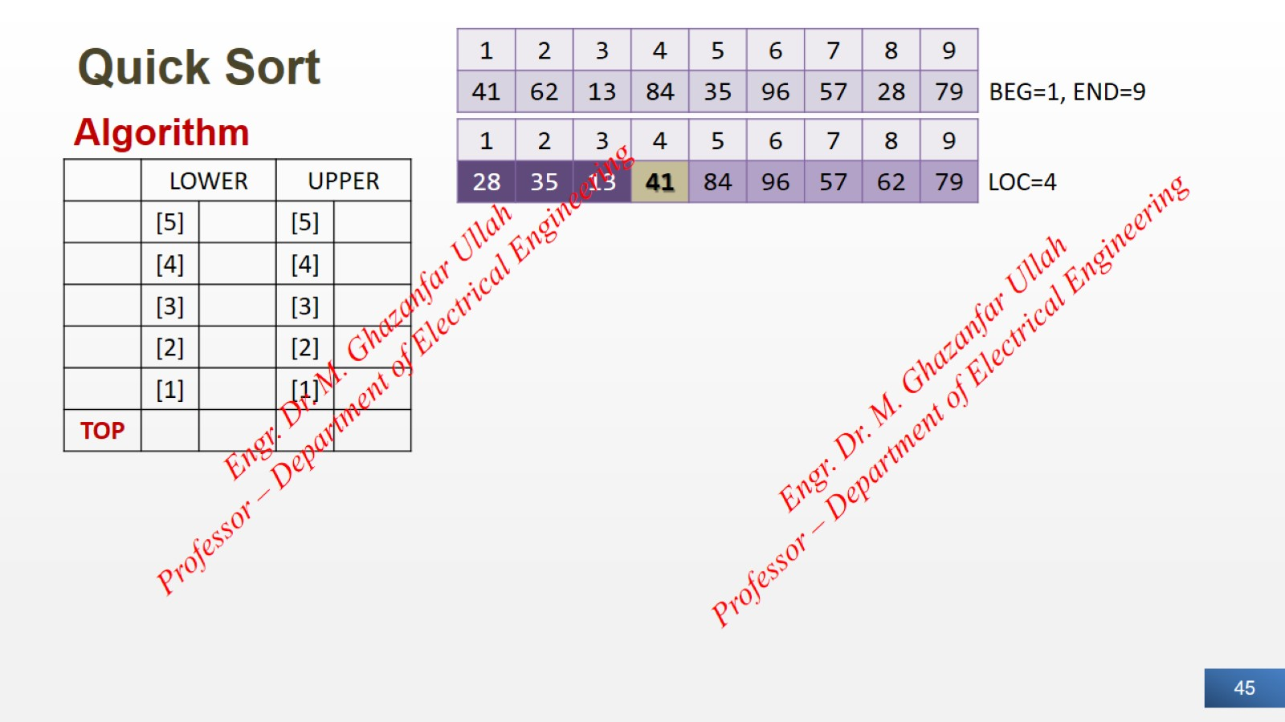
Quick Sort

Slide 46
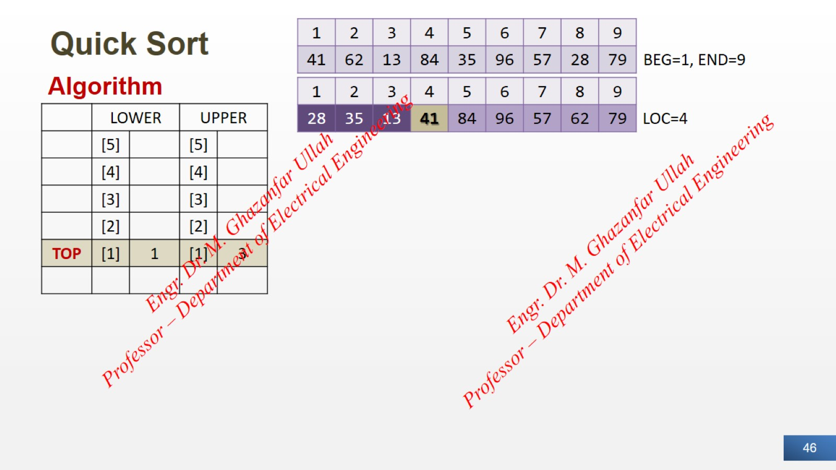
Quick Sort

Slide 47
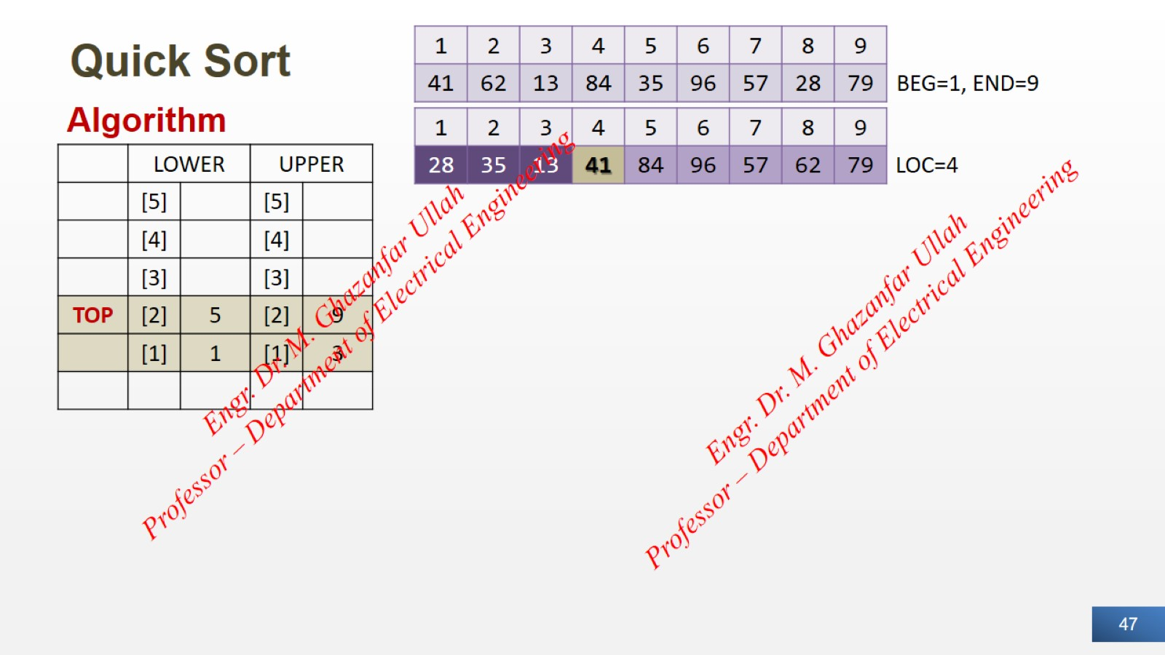
Quick Sort

Slide 48
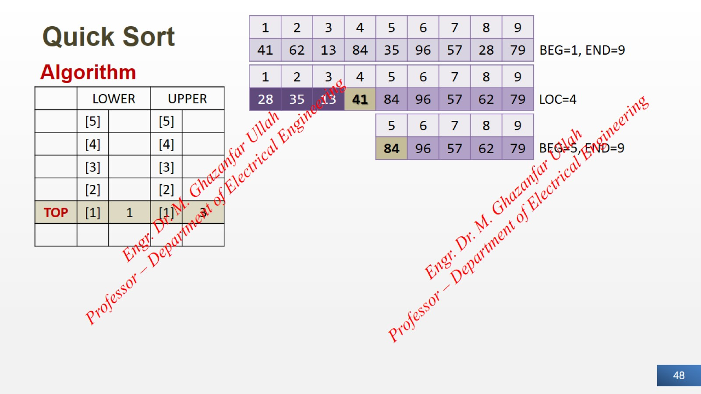
Quick Sort

Slide 49
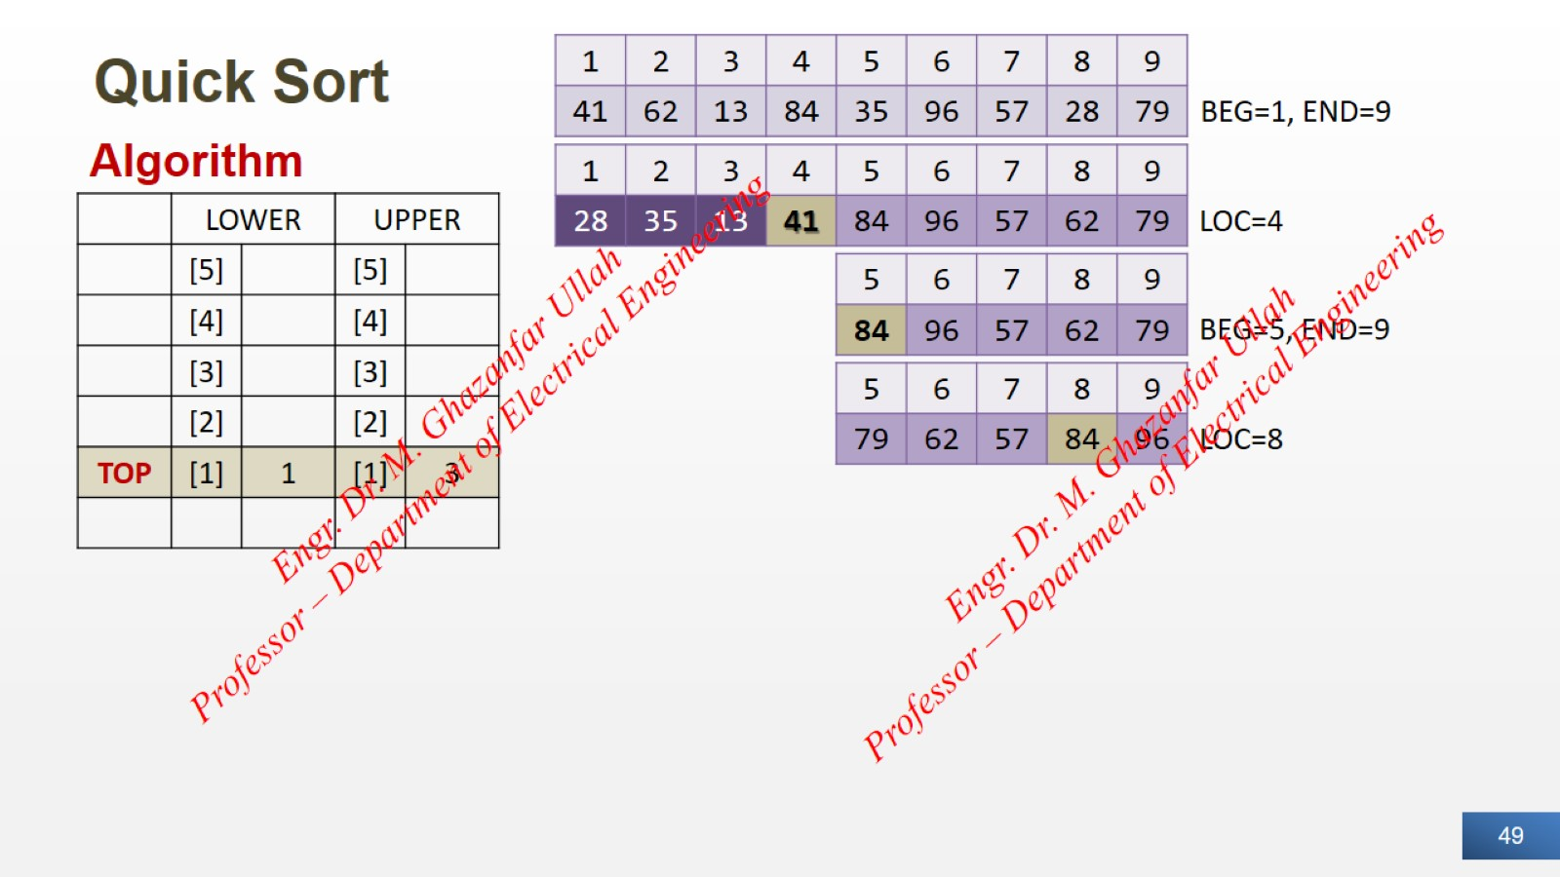
Quick Sort

Slide 50
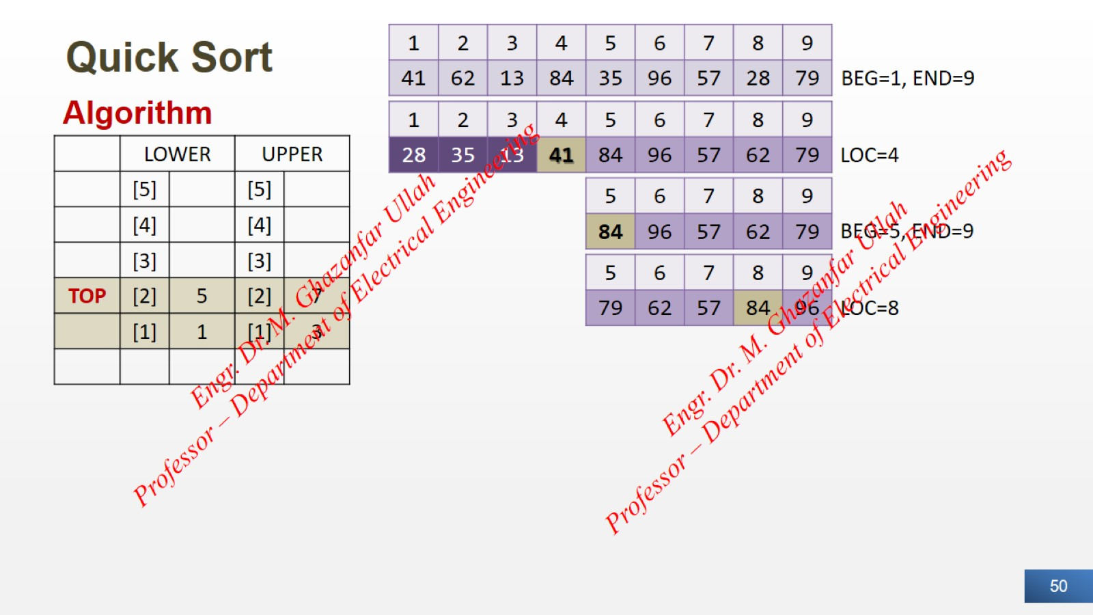
Quick Sort

Slide 51
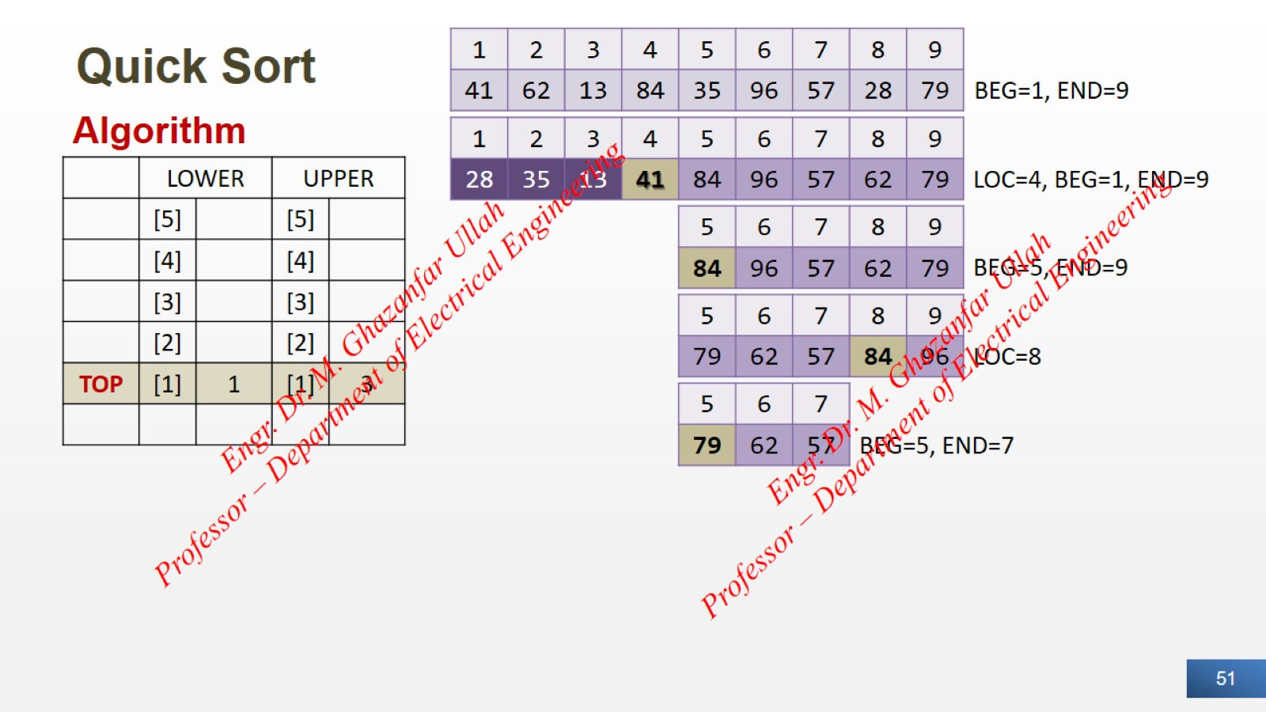
Quick Sort

Slide 52

Quick Sort

Slide 53
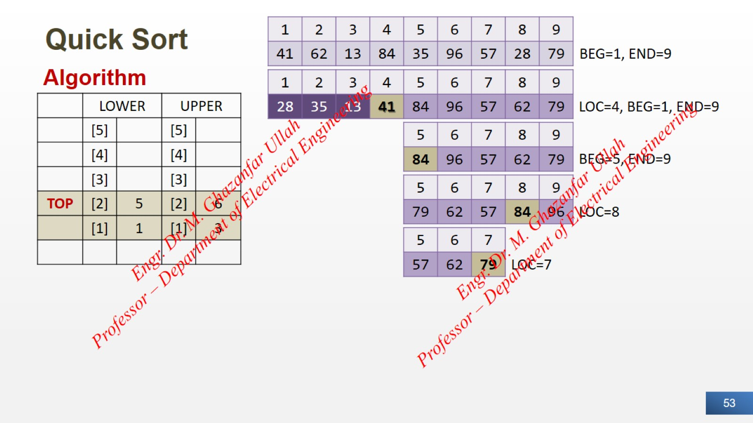
Quick Sort

Slide 54
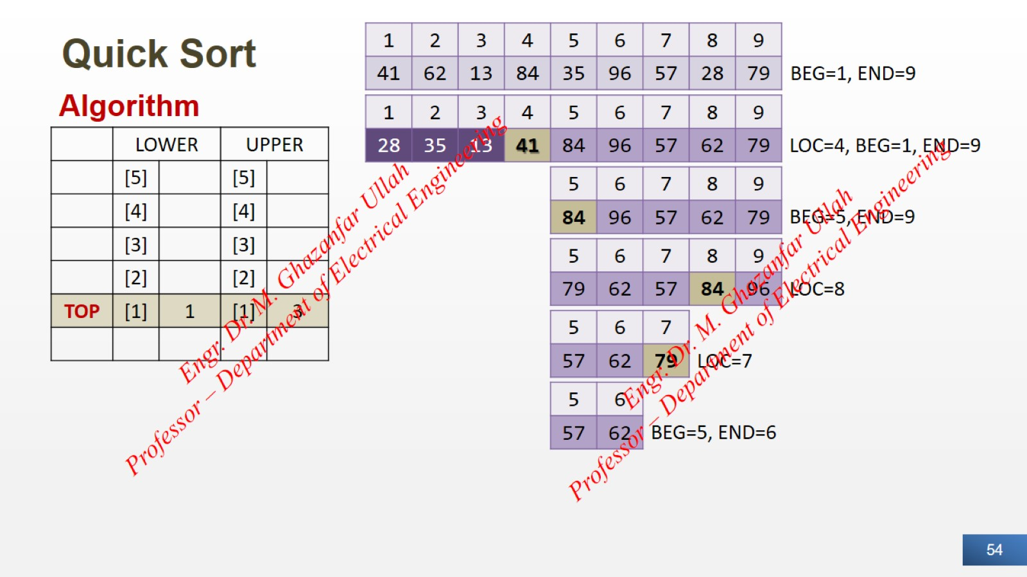
Quick Sort

Slide 55

Quick Sort

Slide 56

Quick Sort

Slide 57

Quick Sort

Slide 58

Quick Sort

Slide 59

Quick Sort

Slide 60

Quick Sort

Slide 61

Quick Sort

Slide 62


